Slide 1
Clerk of Circuit Court
Anna Maria Hodges
2025 Annual Report to the
Milwaukee County Board of Supervisors

Slide 2


Our Mission & Vision Statements
MISSION
The Clerk of Circuit Court and Combined Courts Operations advance the constitutional principle of an impartial and independent judiciary by providing administrative, operational, and record-keeping responsibilities in a manner that maximizes the public’s right to equal access to justice.
VISION
The Clerk of Circuit Court and Combined Courts Operations envision a court system where all litigants, regardless of identity or representation, are afforded equal access to procedural justice.

Slide 3
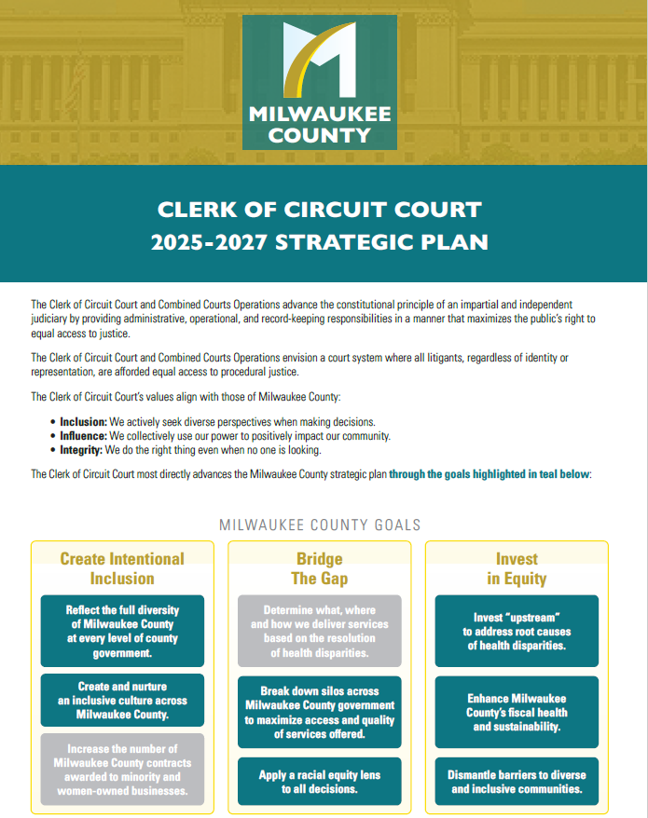
Goal 1
Work on Strategic Plan Goals
GOALS:
Increase Staff Morale and Recognition
Improve Departmental Collaboration Between
COCC & Milwaukee County Offices
Address Physical Silos within COCC
Address Access to Justice Issues In Complex

Slide 4
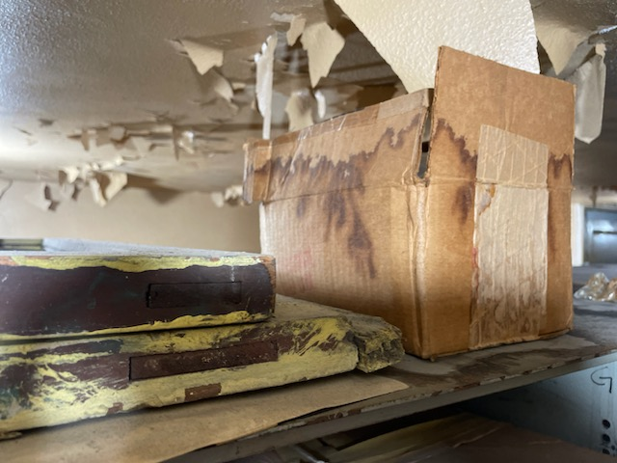
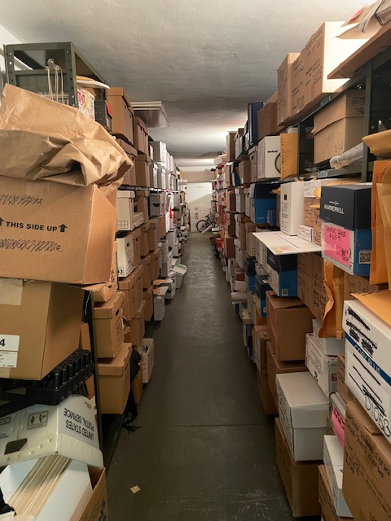
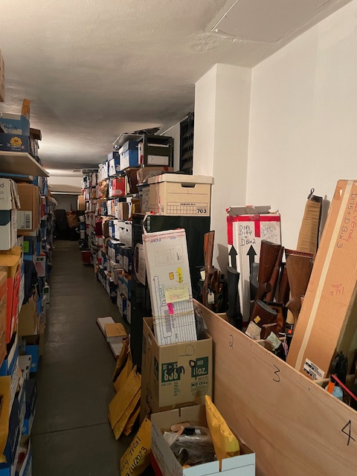
Goal 2
Begin Renovation for New Evidence Room
Clerk of Circuit Courts is responsible to maintain evidence in criminal cases for
as long as 50 years past the last possible date of appeal.
ARPA Funds secured to renovate Room 307 in the Courthouse to house evidence and the Criminal Division Team.
This renovation has not yet begun due to ongoing IJCC project planning. The previously identified space has been reallocated for swing space needs for the new courthouse project.

Slide 5


Goal 3
Collaborate with Child Support Services to Support Innovations in Court Operations
Our office met with Child Support Services to discuss possible changes with how support orders are handled with participants in drug treatment court.
It was determined that, while an interesting idea, it was not feasible with current CCAP limitations and Deputy Court Clerk capacity.
It was good to engage the conversation for both offices to hear the needs of the other. While the project as stated could not happen, the outcome was deeper understanding for both offices.

Slide 6
Other highlights from 2025
113,711 Cases Opened in 2025
68,337 Civil Cases
42,410 Criminal Cases
2,964 Children’s Court Cases
6,314 Client Visits at the Milwaukee Justice Center
32,110 Jurors welcomed to the Courthouse.
Funded a full time position to assist the public when
entering the facility due to federal funding cuts of the
AmeriCorps Navigator Program information desk.

Slide 7
Looking forward to 2026
Continue working on strategic plan goals
Address space and environmental concerns with evidence and staff; as well as physical silos within the Clerk of Circuit Court offices that create barriers to service for the public.
Engage in conversations with the Community Reintegration Center and the Office of the Sheriff to identify and explore mutually beneficial efficiencies to better serve the
community at large.

