Slide 1
Community Reintegration Center
2025 Annual Report to the
Milwaukee County Board of Supervisors

Slide 2

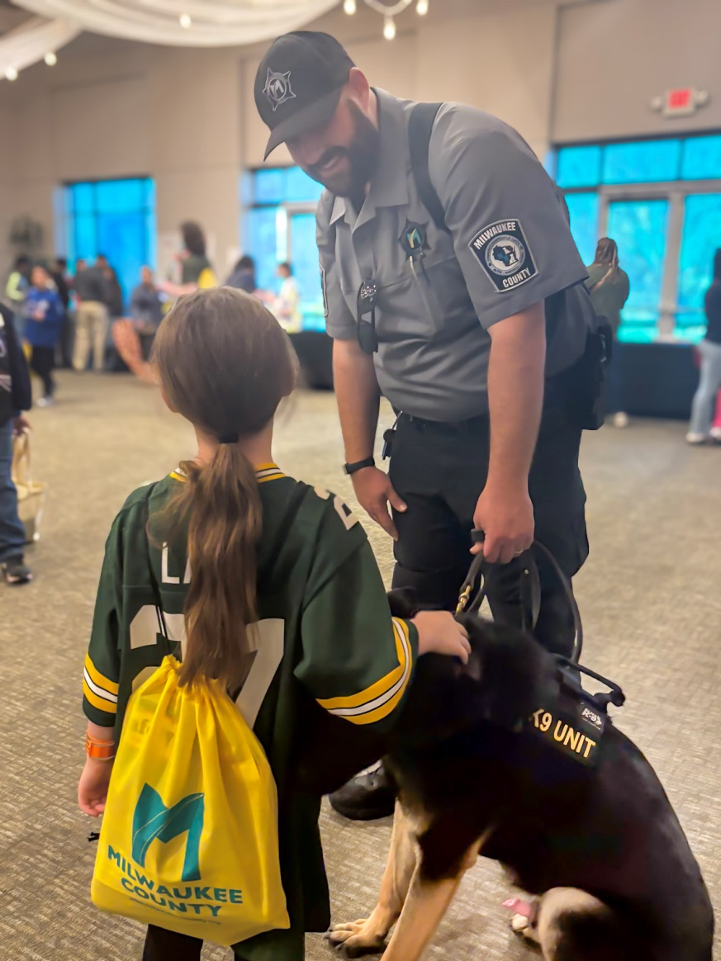
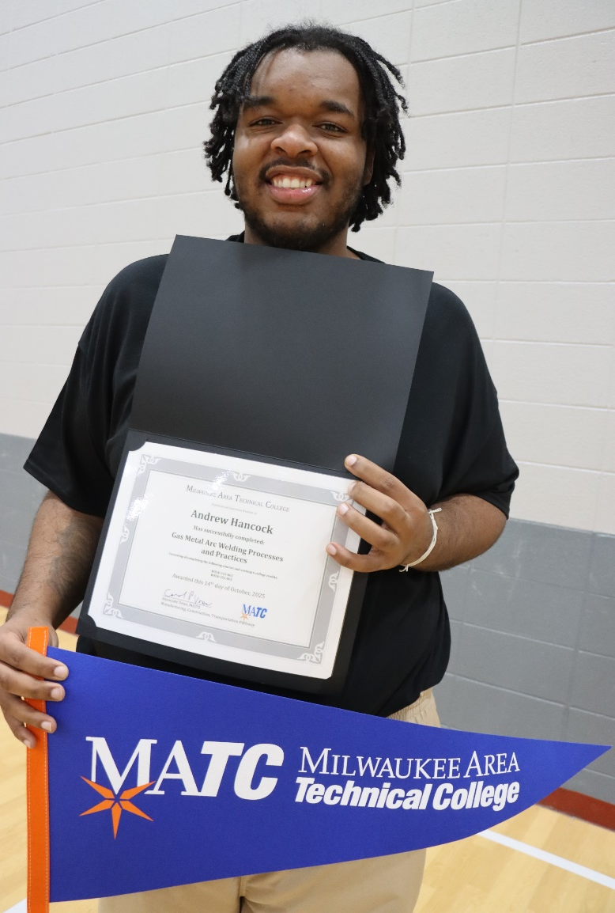

Residents
Employees
Community

Slide 3
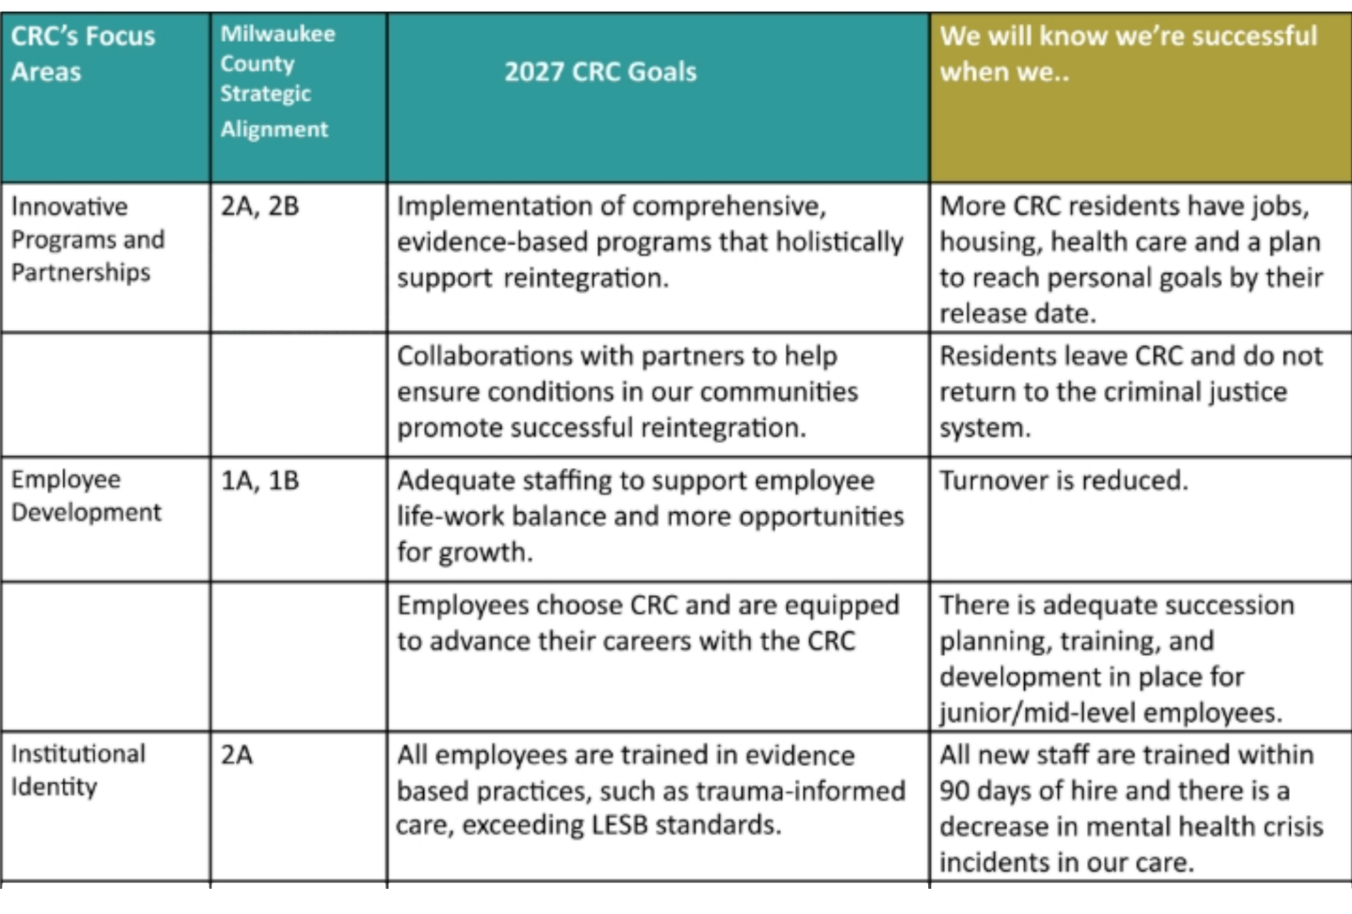
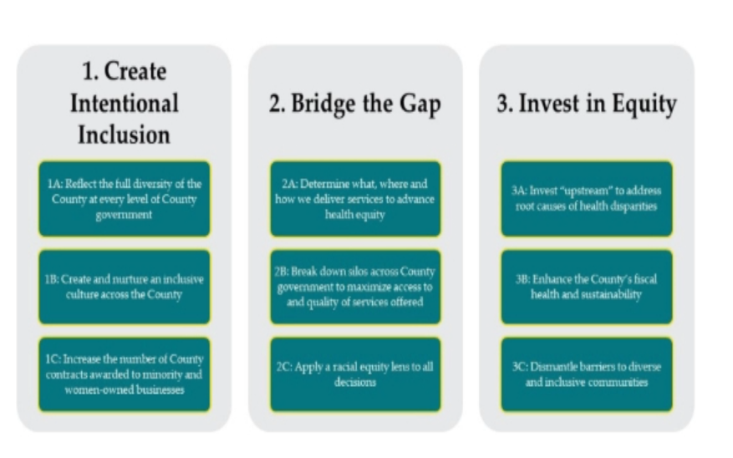
Strategic Plan

Slide 4
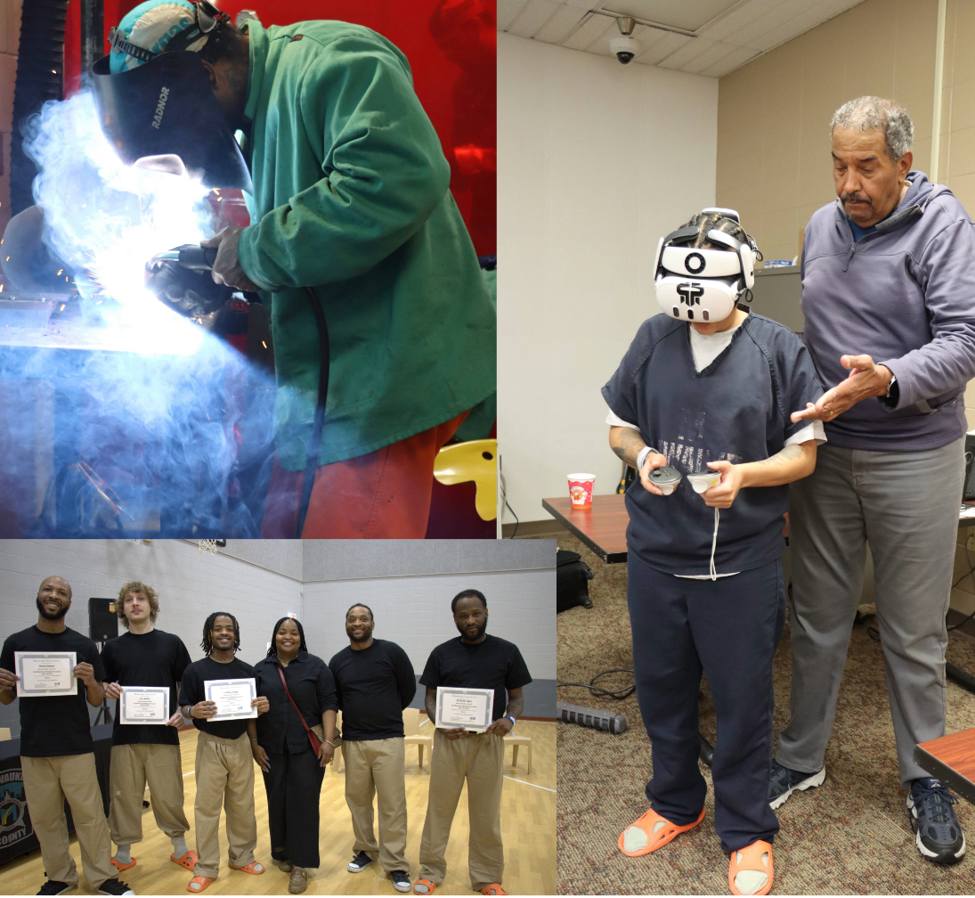
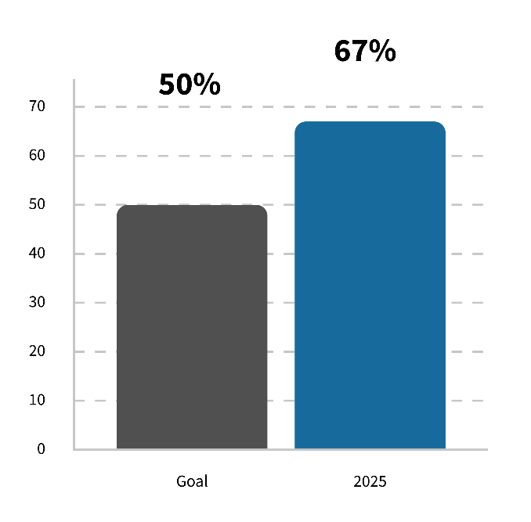
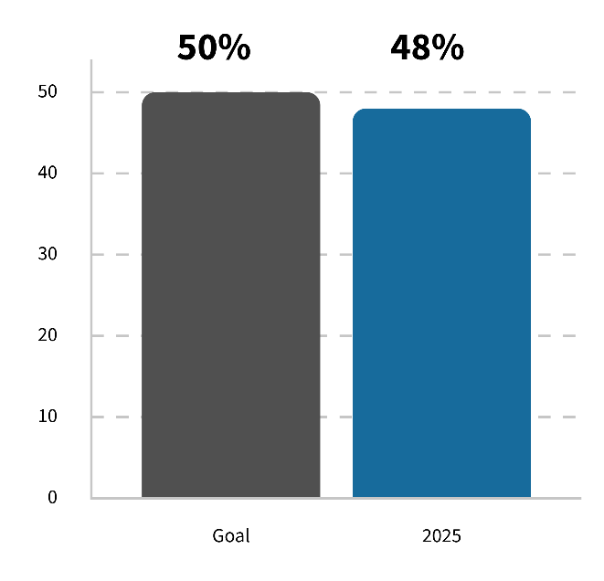
Goal 1
Innovative Programs and Partnerships
Increase percentage of sentenced residents with a reentry plan within 60 days of release to 50% by December 31, 2027.
Increase percentage of sentenced residents participating in CRC programming to 50% by December 31, 2027.

Slide 5
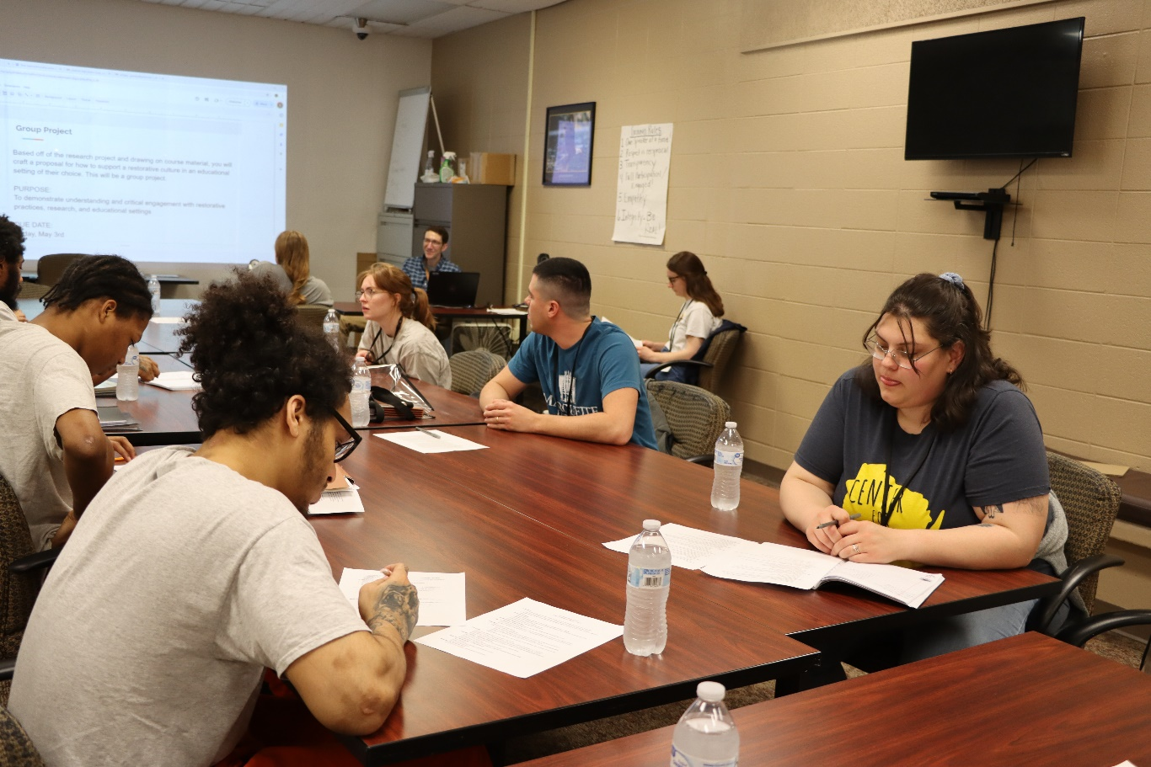
Goal 1
Innovative Programs and Partnerships
Recidivism Numbers
January 1, 2023 – December 31, 2024
183 residents completed programs
13 residents recidivated
9% average recidivism rate

Slide 6

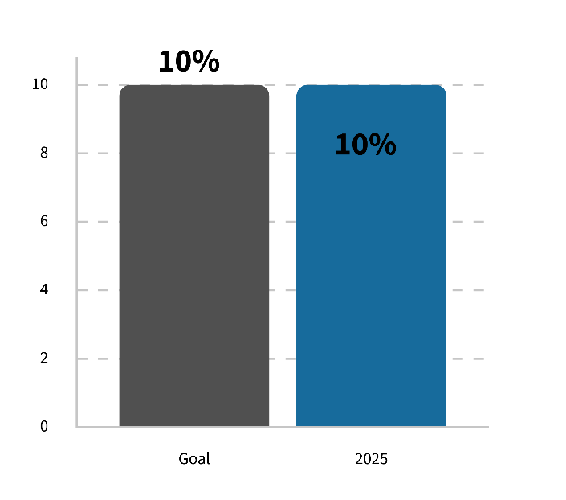
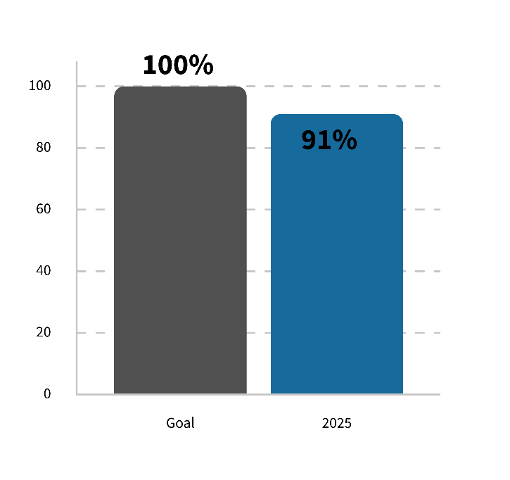
Goal 2
Employee Development
Reduce the correctional officer vacancy rate at the CRC to 10% or less by December 31, 2027.
100% of mid-level staff
complete leadership training by December 31, 2027
** Goal met.

Slide 7

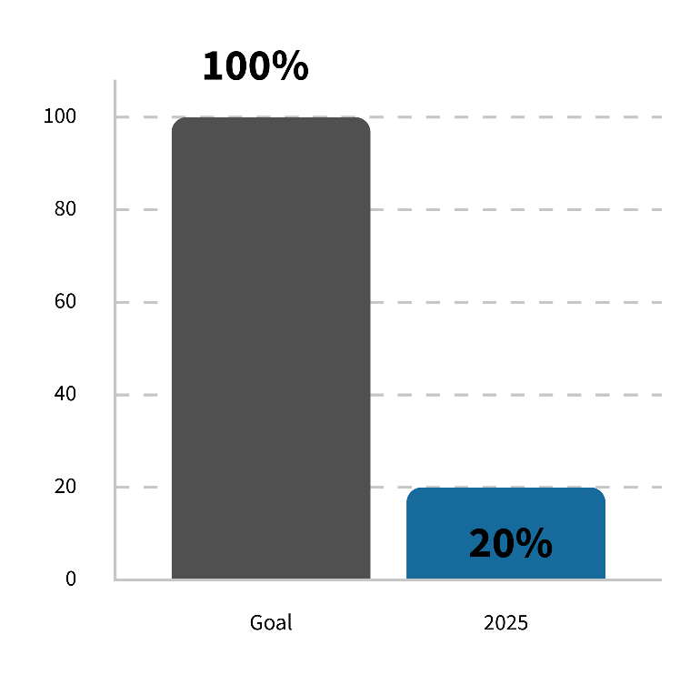
Goal 3
Institutional Identity
Training Department 100% certified to teach Crisis Intervention by end 2025
Completed in 2025
National Institute of Corrections Certifies Crisis Intervention Class
30% increase in weapons trained officers

Slide 8
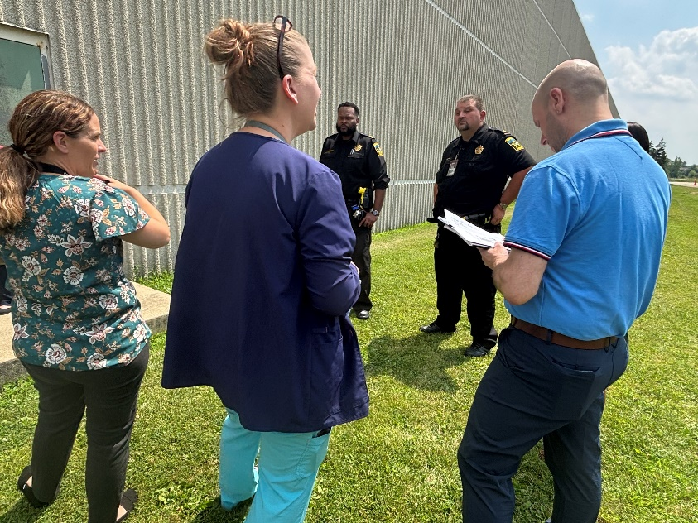
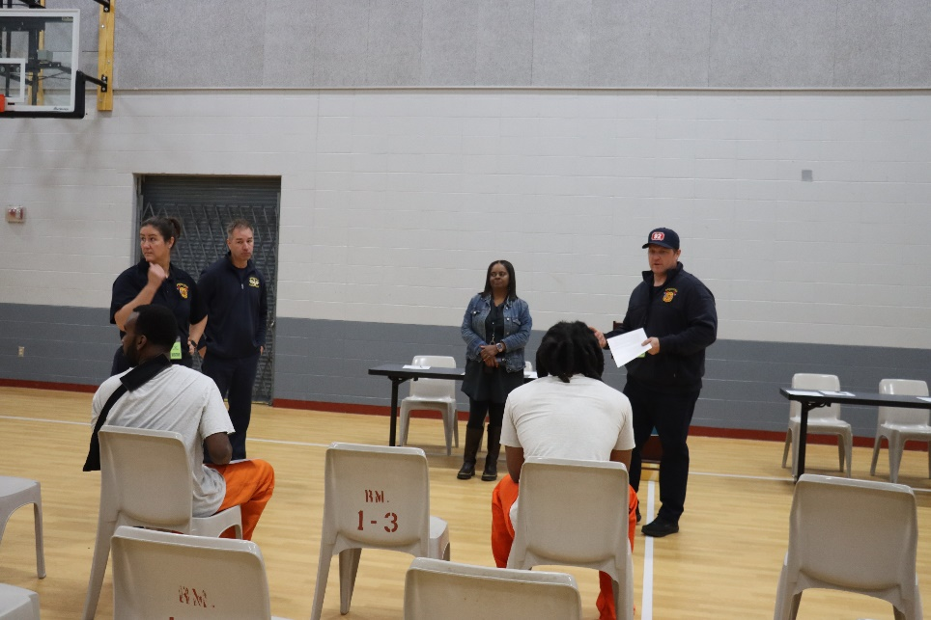
Other highlights from 2025
Alcohol and Other Drug Abuse Programs (AODA)
Emergency Preparedness Planning
Successful Completion of State and Federal Audits
Achieved 100% Compliance
Prison Rape Elimination Act
Wisconsin Department of Corrections

Slide 9
Looking Forward to 2026
Increased Staffing, Overtime Reduction
American Correctional Association Accreditation
Enhanced reentry plans

