Slide 1
Milwaukee County Stroke Alert Data

Slide 2


Slide 3
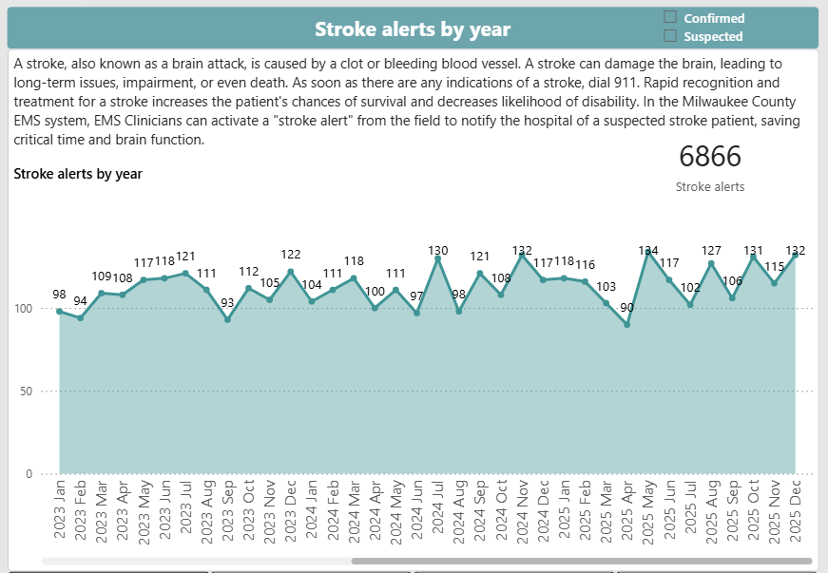

Slide 4
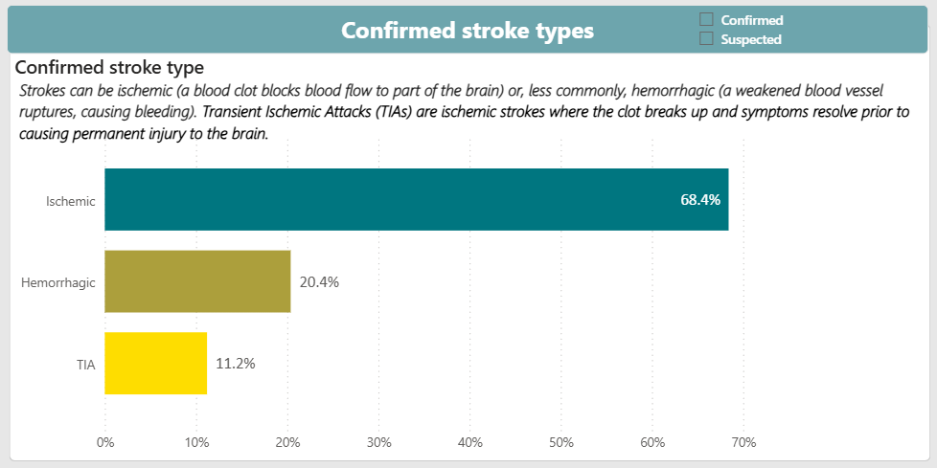

Slide 5
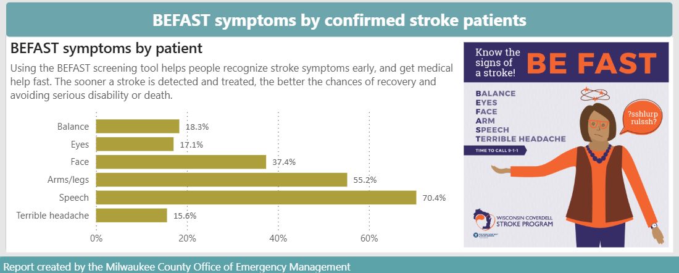

Slide 6
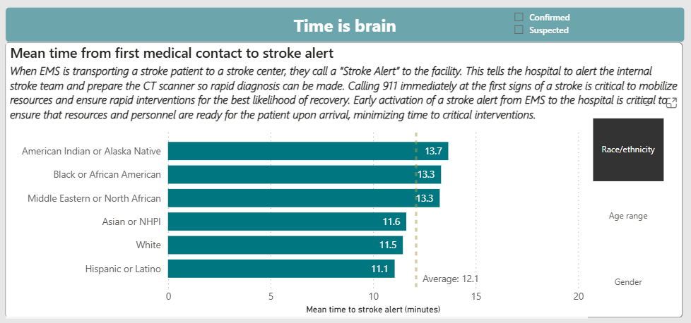

Slide 7
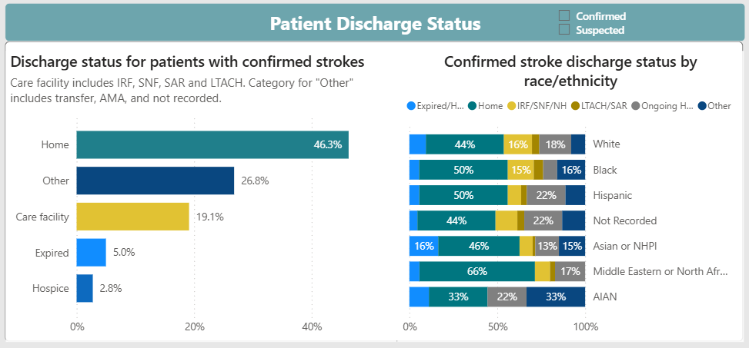
Notes:
94% of people survived from point of discharge.

Slide 8


