Slide 1
Office of the Comptroller
2025 Annual Report to the Milwaukee County Board of Supervisors

Slide 2
Who we are
08
Audit Services Division
Administration
01
Audit Services independently assesses financial operations and controls, ensuring compliance, and operational efficiency.
Administration manages financial operations, ensuring accurate budgeting, reporting, and fiscal compliance.
07
Research Services Division
Central Accounting
02
Research Services supports data-driven decision-making by providing accurate analysis, insights, and research to inform decisions.
Central Accounting oversees financial transactions, ensuring accurate records, and adherence to accounting standards.
Office of the Comptroller
06
Payroll
Financial Services Division
03
Payroll ensures accurate and timely compensation for employees, maintaining compliance with tax regulations and policies.
Financial Services drives strategic decision-making through accurate forecasting and in-depth financial analysis.
05
Account Payable
Capital Finance Division
04
Accounts Payable manages the timely processing of invoices and payments, ensuring accurate financial transactions
Capital Finance manages funding for long-term infrastructure and investment projects, ensuring strategic use of financial resources.

Slide 3
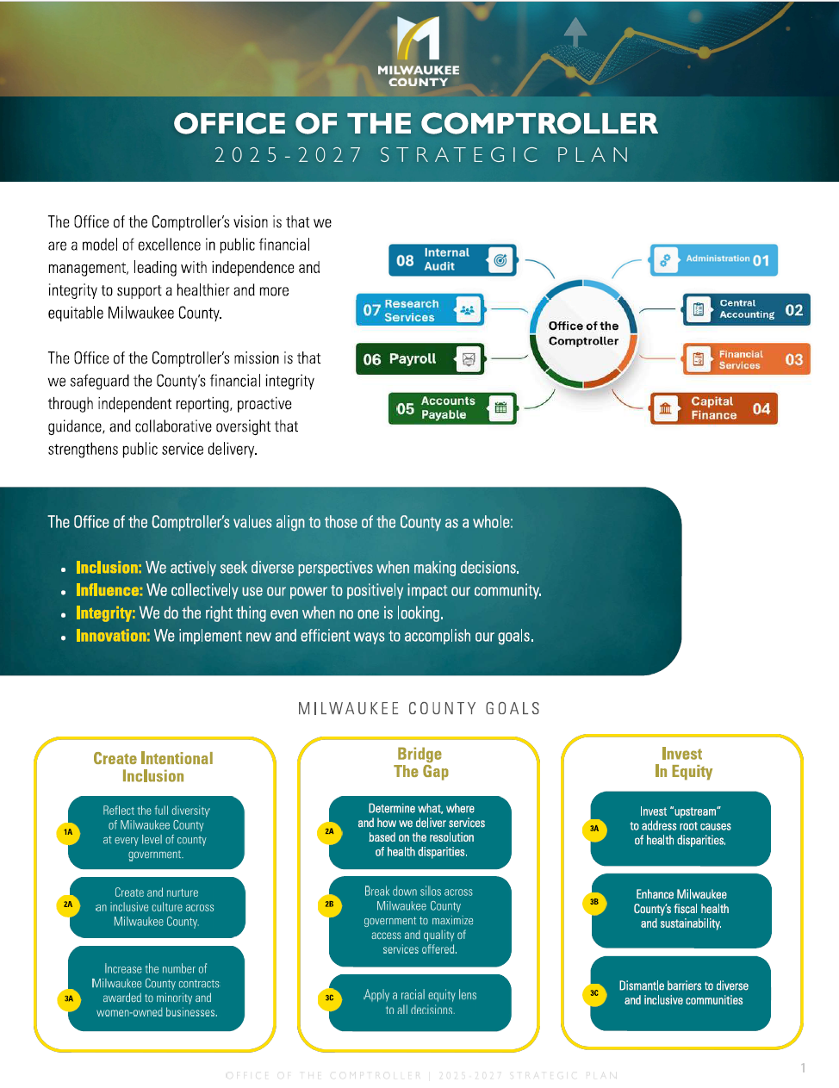
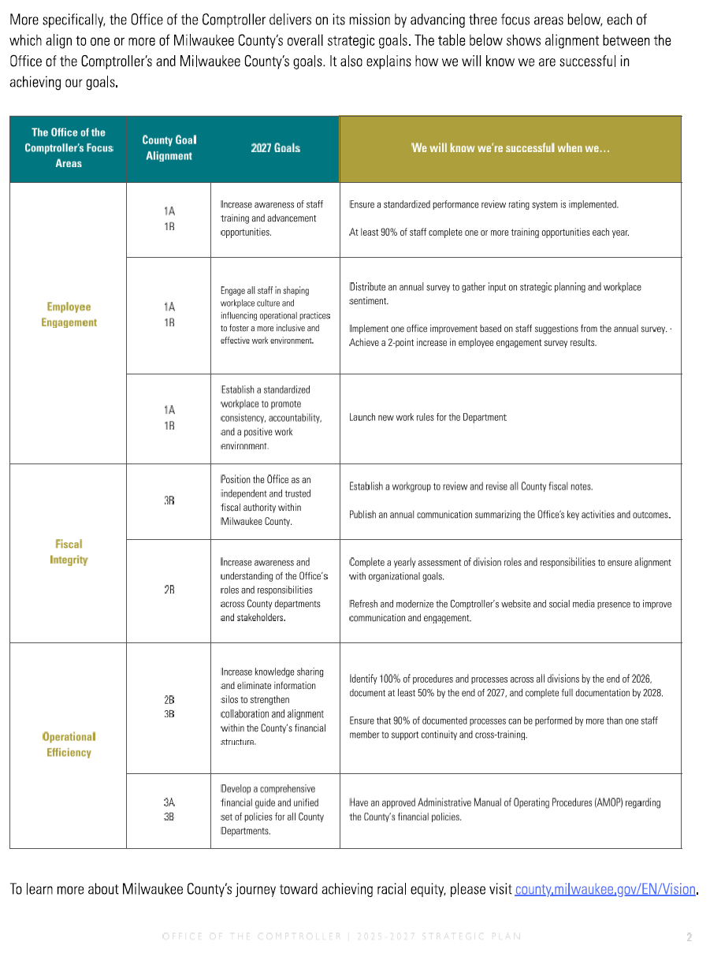

Strategic Plan

Slide 4
2025 Goals
Issue the 5-year fiscal forecast and annual budget analysis by Q4 2025
Both Reports delivered on time in 2025
Presented the 5-year fiscal report in Q2 2025.
Presented a comprehensive analysis of the 2026 Recommended Budget in Q4 2025.
Uphold high levels of public accountability transparency, and decision support
Develop a Strategic Plan By Q4 2025
Strategic Plan completed in Q3, 2025.
Clear objectives
Measurable goals and timelines
Ensure enhanced operational efficiency.
Long-term fiscal sustainability for the County
Achieve the COA for Excellence in Financial Reporting from GFOA
Achieved COA for 2024 ACFR
Improve transparency in annual fiscal reporting.
Ensuring all reports meet GFOA standards, with regular evaluations to ensure inclusivity and equity in the reporting process.

Slide 5
Other highlights from 2025
Payroll
Awareness
Inclusive
Dayforce Wallet
2025 Dayforce Champion award winner
Data Governance participation
Financial Services
Submitted NICRA to Federal Govt.
Established Grants Compliance Framework.
Account Payable
Transparency
Efficiency
AI powered payment processing
Reduced manual data entry
ACH-EFT payment security software
Capital Finance
Updated County’s Debt Service Policy.
Fully supported 2026 CIC meetings.
Integrity
Audit Services Division
Conducted 3 performance audits.
Continued management of Fraud Hotline.

Slide 6
Looking forward to 2026
Employee Growth & Engagement
Organizational Culture & Workplace Development
Operational Efficiency and Process Maturity
Strategic Influence and Fiscal Integrity
Expand training and advancement opportunities (>90%).
Increase engagement through surveys and feedback.
Foster inclusive and collaborative workspace.
Establish consistent work rules and accountability structures.
Engage staff in shaping operational practices.
Drive continuous improvement based on employee input.
Position the office as an independent, trusted fiscal authority.
Strengthen understanding of roles across departments.
Enhance stakeholder engagement via modernized communications.
Document and standardize processes across all divisions. (100% by 2027)
Enable cross-training to ensure continuity and collaboration. (90% coverage).
Develop unified financial policies and procedures.
This structure highlights continuous growth at the individual, team, organizational, and systems levels, which aligns cleanly with our Strategic Plan.

