Slide 1
Milwaukee County Parks
2025 Annual Report to the Milwaukee County Board of Supervisors

Slide 2
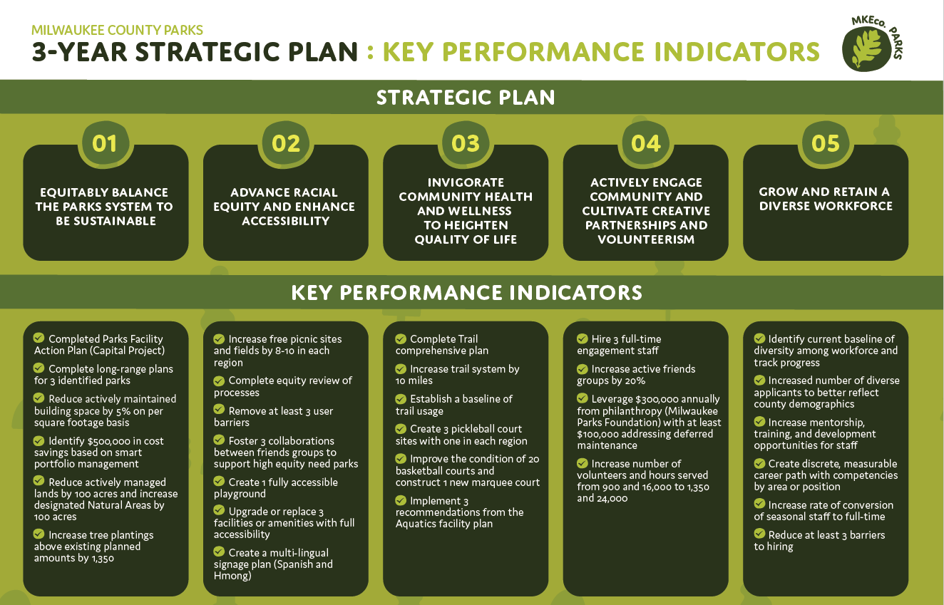

Strategic Plan

Slide 3
Goal 1
Transition to more natural areas - reinvest in forestry, tree canopy, and non-maintained areas; use environmentally sustainable techniques
Increase acres of natural areas

Slide 4
Goal 2
Prioritize healthy activity through our capital planning and investments
Implement three recommendations from the Aquatics facility plan

Slide 5
Goal 3
Transform less used recreational spaces and experiences based on user demand and preferences
Create three pickleball court sites with one in each region (North, Central, South)

Slide 6
Goal 4
Assess and reduce barriers for different users through an equity review; identify changes to make processes more accessible
Increase free picnic sites and fields by 8-10 in each region

Slide 7
Goal 5
Increase the number of volunteers helping with specific and meaningful improvements (invasive species removal, trail maintenance, park clean-ups)
Increase the number of volunteers helping in Parks to 1350

Slide 8
Other highlights from 2025
In addition to the 5 Key Performance Indicators that are included in the Scorecard, Milwaukee County Parks made significant progress on the following goals in 2025 –
​Provide multi-lingual signage in targeted areas and multi-lingual options for external communications and processes – Parks has produced a multi-lingual signage plan that will guide the languages used in future sign installations
Increase the rate of conversion of seasonal to full-time staff – Parks began tracking this during 2025 and has shown improvement in the rate of full-time positions being filled by existing seasonal employees (36% in 2023, 46% in 2024, 50% in 2025)
Complete an equity review of processes
Transition to more natural areas - reinvest in forestry, tree canopy, and non-maintained areas; use environmentally sustainable techniques
Create discrete measurable career path with competencies by area or position - a career pathway tool was created that shows requirements and competencies needed to advance throughout the entire department

Slide 9
Looking forward to 2026
Request for 2027 capital projects in service of the Strategic Plan
  Implementation of Aquatics Facility Plan
  Expansion of trail system
  Improving basketball courts
Trail Network Plan – planning work completes
Reduce operating expenses by $500,000 through building portfolio management

