Slide 1
Social Isolation & Loneliness in Older Adults
Kaisa Kerrigan, Community Health Coordinator
Milwaukee County Area Agency on Aging

Slide 2

“Our epidemic of loneliness and isolation has been an underappreciated public health crisis that has harmed individual and societal health.”
Our relationships are a source of healing and well-being hiding in plain sight – one that can help us live healthier, more fulfilled, and more productive lives...”​
U.S. Surgeon General Dr. Vivek Murthy​
May 3, 2023
Notes:
Declared an epidemic
Other epidemics- opioid, obesity, smoking. How have you seen SIL present in your community or society?

Slide 3
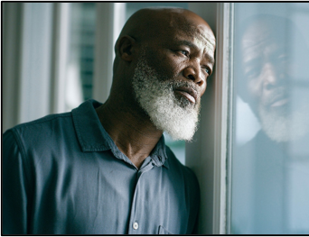
Social Isolation and Loneliness-What is the difference?
Social Isolation
Loneliness
Subjective. A distressing feeling
Can be felt regardless of whether they are alone or in the company of others
Varying degrees of loneliness; there are differences in frequency, duration, and intensity.
*A person may be Lonely but not Socially Isolated and vice versa
Objective. The # of relations and contacts a person has
when an individual Lacks Opportunities to be Socially Connected
*May not be unpleasant for the person; they may choose to isolate. Doesn’t make a person lonely.
At our Core, Humans are Social Beings
Notes:
We often talk about them in the same context, but there are important differences.
Social Isolation-
Someone who is socially isolated is physically separated from others.
Social isolation can increase the likelihood of social loneliness, but it is possible to be
isolated without being lonely, and it is possible to be lonely without being isolated.
Loneliness- more of a feeling. \
The gap between a person’s desired level of social contact and their actual level of social contact.
Although we often say that someone is lonely, there are differences in frequency and
duration, as well as intensity.
How often you feel lonely, how long you feel lonely for, and how intensely your feelings are can change from person to person, and be a response to changing life circumstances.
Loneliness may be an occasional, transient feeling that someone can manage. In fact, an
intensity of feeling that is short lived may helpfully motivate individuals to reconnect with
other people.
When we feel lonely often or always, this is defined as chronic loneliness. This long standing
nature of loneliness can inhibit our social connections and cause harm.

Slide 4
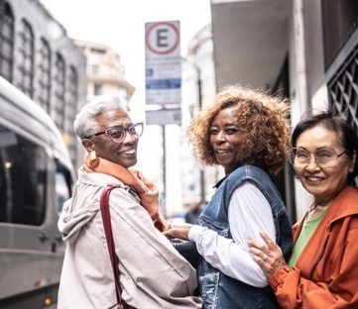
Social Connectedness
creates a sense of belonging, being cared for, valued and supported.
“Connection is why we are here. [We are] wired to love, to be loved, and to belong. When [these] needs are not met, we don’t function as we were meant to. We break. We fall apart. We numb. We ache. We hurt others. We get sick.” –Brene Brown
What does belonging look like to you?
Notes:
Social connectedness, which is the opposite of SIL is the degree to which people have and perceive a desired # quality and diversity of relationships
. There are many ways we can connect socially, and many ways we can lack social connection.
Belonging is a fundamental juman need.
What does a day or week of feeling more connected look like to you?
Can you tell me about a time you felt more connected?
it is critical to carefully consider equity in any approach to addressing social connection, as access and barriers to social opportunities are often not the same for everyone and often reinforce longstanding and historical inequities

Slide 5
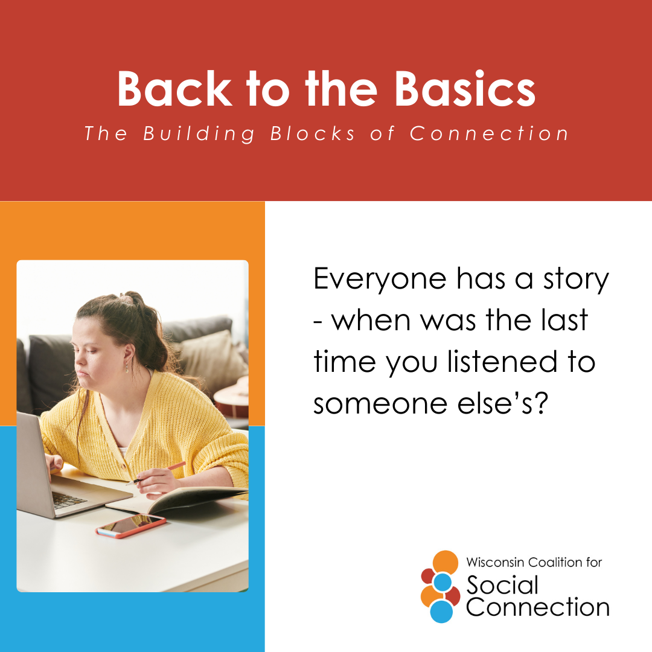
Three Vital Components of Connection
Structure
# of relationships
Function
Degree to which others can be relied upon for various needs
Quality
The degree to which relationships and interactions with others are
Variety of relationships (co-workers, friends, family, neighbor)
Frequency of interactions
helpful,
positive,
satisfying
Notes:
Structure examples: household size,
family size, friend circle size
Function: Emotional support, mentorship, support in a crisis
Quality: (vs. negative, unhelpful, or unsatisfying)
relationship satisfaction, relationship strain, social inclusion or exclusion
You can see how you could have a large # of relationships, but if your connections don’t feel reliable, you don’t feel valued/cared for, and and do not create a sense of belonging, you could feel very lonely even if you are not technically socially isolated.
An individual’s level of social connection is not simply determined by the number of close relationships they have.
Consider two examples: first, an individual who is part of a large, highly-involved family, and second, an individual who has regular contact with colleagues through work but has little time for personal relationships outside of work. In each case, such an individual is not objectively isolated and may not feel subjectively lonely. However, in both cases key measures of isolation and loneliness may miss whether they are reaping the benefits of social connection in other ways, such as feeling adequately supported or having high-quality, close relationships.

Slide 6
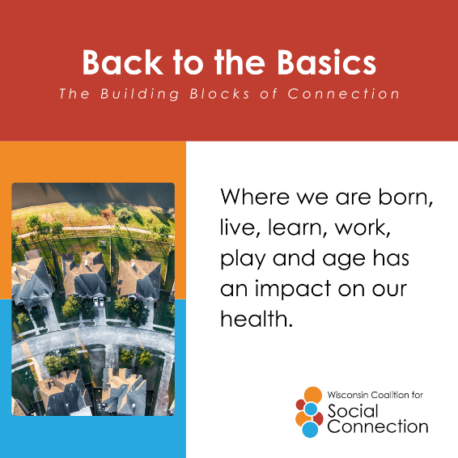
Factors that Can Shape Social Connection
Individual
Relationships
Chronic disease
Sensory and functional impairments
Mental health
Physical health
Personality
Race
Gender
Financial status
Life stage
Structure, function, quality
Household size
Characteristics and behavior of others
Community
Society
Outdoor space
Norms and values
Housing
Workplace
Local government
Local business
Community organizations
Health care
Transportation
Public policies
Tech environment and use
Civic engagement
Historical inequities
Social connection is more than a personal issue
Notes:
INDIVIDUAL: Social connection is most often viewed as driven by the individual — such as presence of a chronic disease, or mental health struggles, your personality type, other factors listed here, and stage in life- which we will get to later.
These can influence motivation, ability, or access to connect socially.
RELATIONSHIPS: As we’ve seen, the level of one’s connection is also dependent on the structure, function, and quality of relationships. And many other factors that we may have very little control over.
It is also shaped by the social infrastructure of the community (or communities) in which one is born, grows up, works and grows old. Like the quality and access to outdoor spaces, adequate housing, community organizations, decisions made by local government,
Societal factors influence communities through broader social policies, cultural norms, the technology environment, the political environment,.
Moreover, individuals are simultaneously influenced by societal-level conditions such as cooperation, discrimination, inequality, and the collective social connectedness or disconnectedness of the community.
All of this to say,, social connection is more than a personal issue.
Because many contributors to social connection go beyond an individual’s control, in order to promote health, change is needed across all levels that shape the availability of opportunities for social connection.

Slide 7
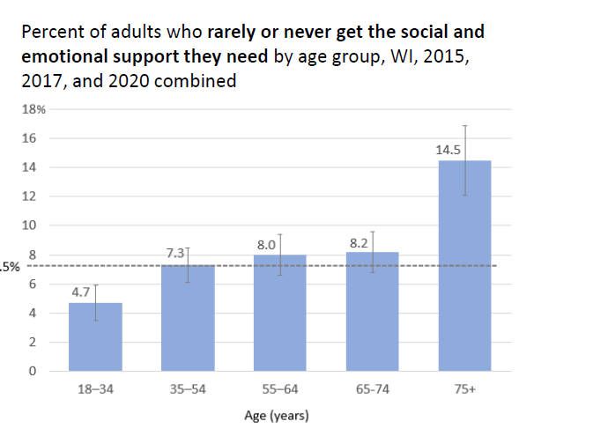
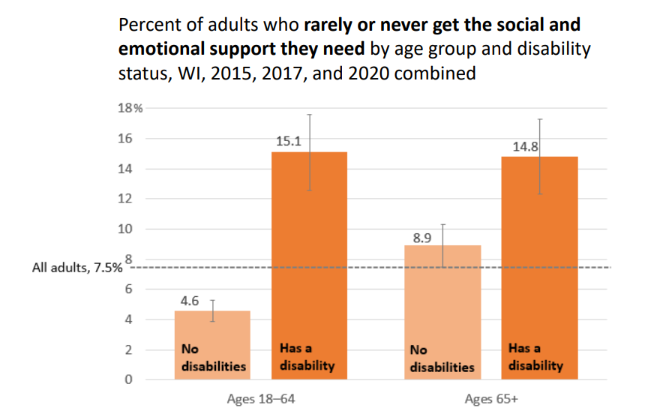
Adults ages 75 and older were the most likely to lack the social support they needed.
Wisconsin Department of Health Services, Division of Public Health. Social and Emotional Support Data in Wisconsin: Older Adults and People with Disabilities(P-03418). April 2023.
Who is lonely?
Adults with disabilities were more likely to lack the social support they needed regardless of age
Notes:
First lets look at the graph on the right. Adults with disabilities were more likely to lack the social support they need regardless of age.
Then we see adults age 75+ were the most likely to lack adequare social support.
Our younger years are often the point in our lives when we are meeting more people and relationships are created and built upon. As we age, those relationships can change as people transition to different stages in their lives, Illness, moves, job transitions, and countless other life events. Also as we just pointed out changes in one’s community and society can affect social connections, so it is expected and not abnormal that the amount and quality of social connections change over time and periods of loneliness are not necessarily concerning. But how long we remain socially disconnected for is worth paying attention to. chronic loneliness (even if someone is not isolated) and isolation (even if someone is not lonely) represent a significant health concern.
Additionally, as we age, more risk factors come into play. Which we will explore further in a minute.

Slide 8
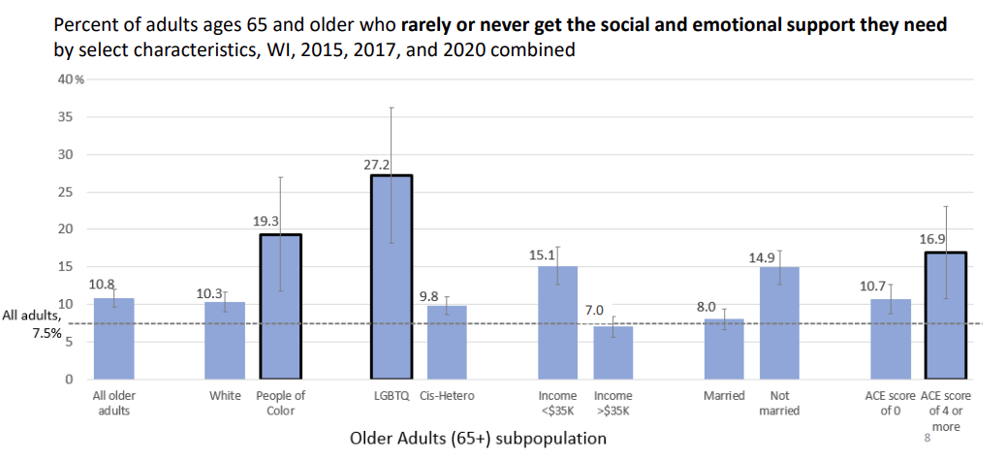
At-risk groups
Wisconsin Department of Health Services, Division of Public Health. Social and Emotional Support Data in Wisconsin: Older Adults and People with Disabilities(P-03418). April 2023.
Notes:
Among adults ages 65 and older, those who were LGBTQ, people of color, or had an ACE score of 4 or more were the most likely to lack the social support they needed.ACEs abuse, neglect, socioeconomic factors.
he number of adverse childhood experiences a respondent reported out of the following: parental divorce, physical abuse, emotional abuse, sexual abuse, neglect, mental illness of an adult caregiver, illicit drug use or alcoholism of an adult caregiver, incarceration of a household member, or physical violence between adult caregivers

Slide 9
Risk Factors for Social Isolation and Loneliness
Chronic health conditions
Limited mobility
Living alone
Financial insecurity
Grief and loss
Lack of transportation
Cognitive impairment/dementia
Hearing/vision impairment
Caregiving responsibilities
Notes:
As mentioned, more risk factors for social isolation and loneliness come into play as we age. Take a look at the risk factors and think about how each of them can present themselves more strongly as you get older. currently, studies find the highest prevalence for loneliness and isolation among people with poor physical or mental health, disabilities, financial insecurity, those who live alone- one in 4 older adults live alone- huge risk factor. Other risk factors OA are more likely to face- lack of transporation, grief and loss, hearing and vision loss, and as Kayla will touch on- cognitive impairments are caregiver responsibilities!
For example, while the highest rates of social isolation are found among older adults, young adults are almost twice as likely to report feeling lonely than those over 65, lacking meaningful relationships and a sense of belonging.

Slide 10
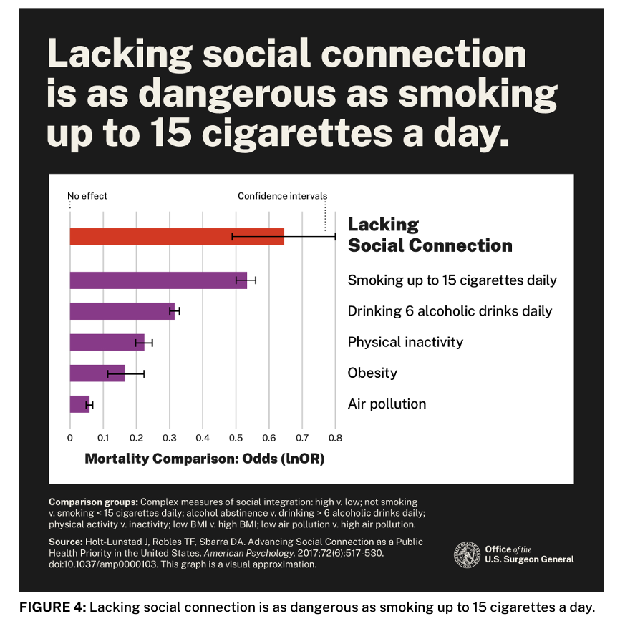
Notes:
Health effects of social isolation and loneliness
“Over four decades of research has produced robust evidence that lacking social connection— and in particular, scoring high on measures of social isolation—is associated with a significantly increased risk for early death from all causes.”
More recent estimates, based on synthesizing data across 148 studies, with an average of 7.5 years of follow-up, suggest that social connection increases the odds of survival by 50%.
Indeed, the effects of social connection, isolation, and loneliness on mortality are comparable, and in some cases greater, than those of many other risk factors including lifestyle factors (e.g., smoking, alcohol consumption, physical inactivity), traditional clinical risks factors (e.g., high blood pressure, body mass index, cholesterol levels), environmental factors (e.g., air pollution),
More broadly, lacking social connection can increase the risk for premature death as much as smoking up to 15 cigarettes a day.4

Slide 11
How does SIL affect health?
Physical Health
Mental Health
Increased risk for anxiety and depression
Loss of self-confidence and self-esteem
Daily routines and self-care may become harder to maintain
Increased risk of substance and prescription drug abuse
Increased progression of frailty
Increased risk of dementia
Decreased memory and learning
Struggle in fighting off smaller illnesses
Notes:
And it goes both ways, a physical and mental health problems are a both a cause and effect of loneliness and social isolation, can increase our likelihood of
Experiencing loneliness and can develop as a result of loneliness.
Other negative health impacts of SIL- examples-
Loneliness can affect how we think and feel about ourselves and the world around us.
include a loss of self confidence and
self-esteem, increased sensitivity to social rejection, and an increased risk of stress,
And addiction

Slide 12





RX Social Connect: Social Isolation and Loneliness Reduction Project
Goal: train community pharmacists in screening older adults for social isolation and loneliness (SIL) and ultimately referring participants to community resources and a mental health provider as needed for appropriate follow-up.
A “social prescription”
Notes:
Milwaukee County AAA offers a myriad of programs and activities that increase social connection and promote health: including Evidence Based Health Promotion classes, congregate meal sites, social programming at senior centers, and transportation.
But By definition, those that are socially isolated are not engaged in the community, much less in AAA sponsored activities. Thus, the first challenge in addressing social isolation and loneliness is to identify individuals who are lonely. The second is to determine what risk factors someone is facing that might be contributing to their SIL, and thirdly, to connect them to resources to remove barriers to social connection.
TO achieve this- Milwuakee County has partnered with MCW, VV, PSW and is currently piloting: Rx Social Connect-
Goal-
Through a model of social prescribing, patients who are identified as “lonely” are formally referred to local non-clinical services that help empower them to improve their health and foster meaningful community connections.

Slide 13

Why pharmacists?
-most accessible healthcare provider
-a pharmacist may be one of the few points of contact in their lives
-"Given the profound consequences of loneliness and isolation, ​we have an opportunity, and an obligation, to make the same investments in addressing social connection that we have made in addressing tobacco use, obesity, and the addiction crisis“ – Vivek Murthy, U.S. Surgeon General
Notes:
Most patients see their pharmacist and visit a pharmacy more often than they see their PCP or go to the clinic.
for someone who is socially isolated and lonely, a pharmacist may be one of the few points of contact in their lives
To return to the words of the Surgeon General when addressing the epidemic of SIL:
By integrating SIL screening and social prescribing into their practice, pharmacists gain a structured framework for addressing non-medical factors that influence our health
This can complement and enhance any existing pharmaceutical intervention.
What impact can you make by measuring for loneliness?​
​
Better understand loneliness at the local level​
Reach the loneliest people​
Take practical and actionable attempts to reduce loneliness

Slide 14
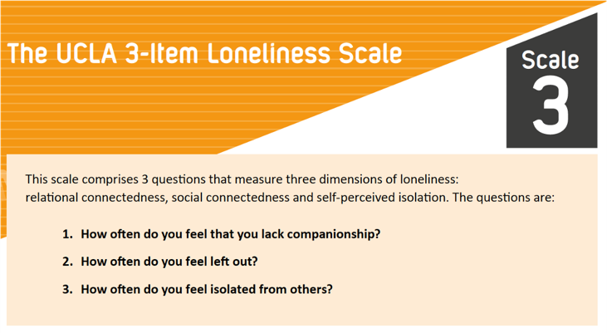
How does it work?
Notes:
Participating pharmacies and pharmacy partners will ask patients Milwaukee County patienst who are over 60 if they would like to take a survey to measure their level of social connection. If they consent, the UCLA 3 item loneliness scale will be administered.
Read questions.

Slide 15
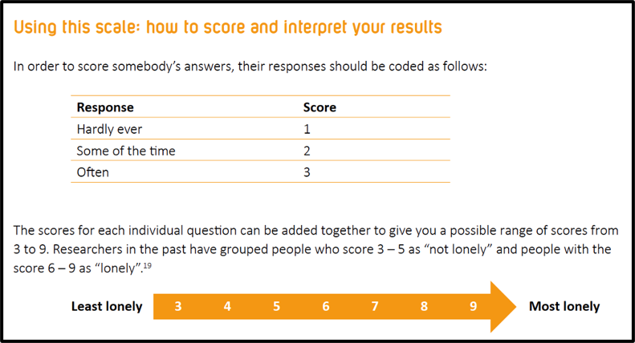
    Widely used across the world – cited over 1,500 times
    Regularly asked as part of the English Longitudinal Study of Ageing (ELSA)
    Proven accurate in various deliveries (self-completed, face-to-face, and telephone)
Notes:
Response will be coded and added up.
Participants who score 6 or more will be referred to Milwaukke County Senior Service Provider- Vital Voices who will follow up with a phone call to the patient.
Staff may find it difficult to ask negatively worded and sensitive questions

Slide 16

Follow- Up Assessment
Vital Voices for Mental Health
Living alone, general feelings of loneliness;
Limited social interaction; few social contacts
Concern with medical debt/bills piling up
Limited mobility
Difficulty completing daily tasks
Difficulty preparing meals/ getting proper nutrition
Lack of transportation
Memory, dementia, neurocognitive concerns
Caregiver status
Hearing/vision loss
Experiencing unresolved grief or loss; bereavement
Self-identified as having fair or poor health; living with chronic conditions
Uninsured
Concerns with anxiety, depression, suicidal thoughts
Notes:
When Vital Voices connects with the participant, they will go through a questionnaire to try to uncover what may be contributing their social isolation or feelings of loneliness. The questions included in the assessment will focus on whether the participant is experiencing some of the bigger modifiable risk factors for SIL that we went through earlier.
Based on the participants responses to the questions, Vital Voices will connect participants to resources, programs, services that they might benefit from.

Slide 17
Social Prescribing in Primary Care

Slide 18
Aging & Disabilities Services Resources
Vital Voices
Older Adults Transportation Services (OATS)
Milwaukee County Caregiver Support Specialists
Dementia Care Specialists
ERAs Senior Network
Riverworks Financial Clinic
Milwaukee County Senior Centers
Milwaukee County Dining Sites/ Meals on Wheels
Jewish Family Services Late Life Counseling
Evidence Based Prevention Programs
Milwaukee County Behavioral Health Services

Slide 19
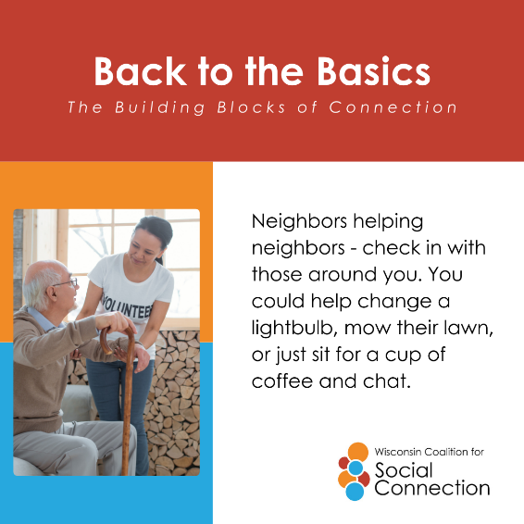
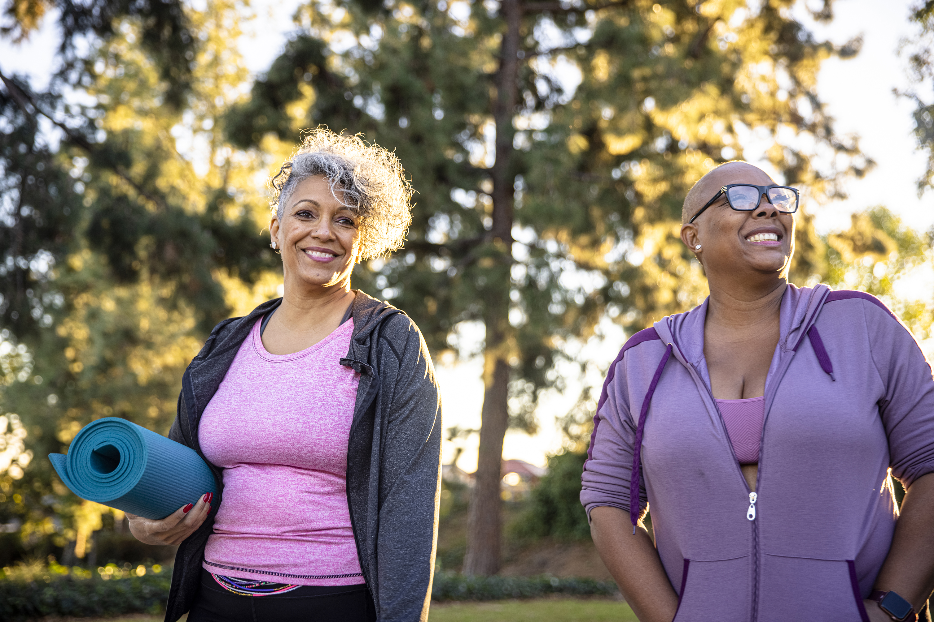
What can I do to improve Social Connection in my community?
Check out your local senior center, grab lunch at a dining site
Volunteer
Incorporate more small social interactions in your day
Invite others to participate in activities with you
“Together, we can build a country that’s healthier, more resilient, less lonely, and more connected.”- Vivek Murthy, U.S. Surgeon General
Notes:
Incorporate more interactions in your day- take the time to chitchat at the grocery store. Try keeping an eye out for opportunities to be kind to people you pass
Volunteer- helping others makes you feel good, and you can connect around an a cause or organization that has meaning for you.
Invite others to participate in activities with you- this could be going to church, going out to lunch, attending a fitness class. Many people may be hesitant to participate in social activities if they are going alone. Give yourself the opportunity to deepen your relationship with someone and let them know they belong.
Check out your local senior center, grab lunch at a dining site- if you haven’t already, explore opportunities to socialize and meet folks who share the same hobbies and interests as you at your senior center, or try something new! Regular attendance is key to building relationships.

Slide 20

The Wisconsin Coalition for Social Connection meets on the first Monday of every month from 2:00 – 3:00 p.m. If you’re interested in being an active Coalition member and attending these monthly leadership meetings, please contact us.
Join the Wisconsin Coalition for Social Connection Network meetings! Network meetings are open to anyone. 2026 meeting schedule: February 17, April 21, June 16, August 18, October 20, and December 15 from 2:00 – 3:30 p.m. The last half hour of each meeting will be for networking and open discussion. Registration is required. Register here.
Coalition committees (currently: Awareness Committee and Policy Champions Committee) meet monthly. If you’re interested in joining a committee, please contact us.

Slide 21
Thank you!!!
Questions, comments, suggestions for increasing social connection?
Reach out anytime:
Kaisa.Kerrigan@milwaukeecountywi.gov
Milwaukee County AAA Community Health Coordinator

