Slide 1
FORWARD with the Bureau of Aging and Disability Resources
Helen Sampson, LCSW
Public Policy Strategist
May 15, 2026
Notes:
The official state motto of Wisconsin is "Forward". Adopted in 1851, it represents the state's continuous commitment to progress, innovation, and looking toward the future. The motto is featured prominently on the Wisconsin state flag and the Great Seal of Wisconsin. [1, 2, 3, 4]

Slide 2
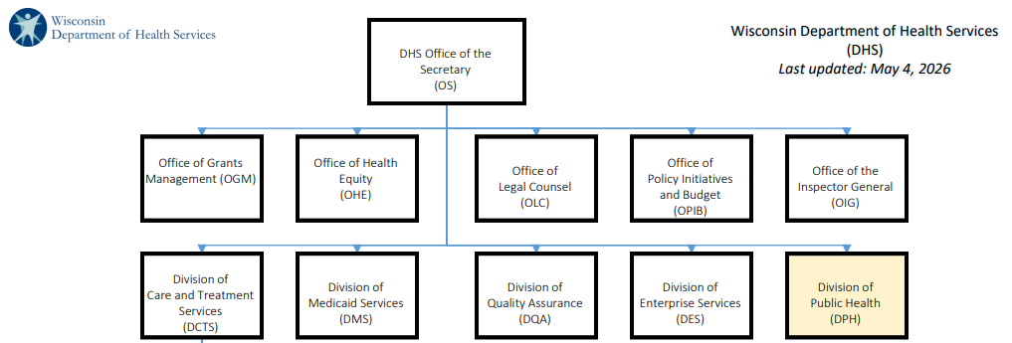
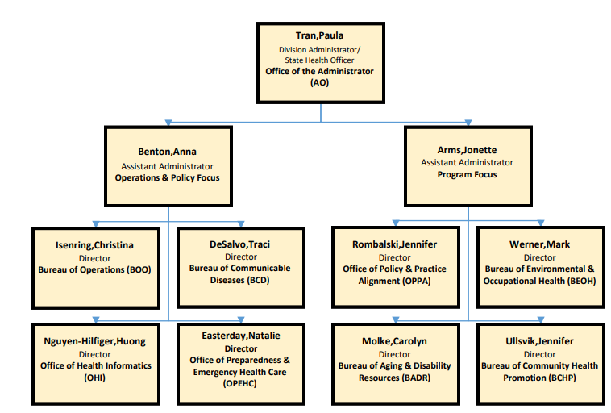
The Bureau of Aging and Disability Resources
Notes:
The Bureau of Aging and Disability Resources (AKA BADR) is the State Unit on Aging and receives the designated federal funds from the Older American’s Act. The Bureau is made up of three offices: Office on Aging, Office for Resource Center Development (ADRC) and the Office for the Promotion of Independent Living (ILC, ODHH, OBVI, Wistech)

Slide 3
Topics for today
Reframing Aging and Disability
Age and Disability Friendly Ecosystem
Next generation

Slide 4
Reframing Aging and Disability
Words Matter

Slide 5
Defining Before Reframing
Ageism is a form of discrimination where people are mistreated based on their age. It is rooted in a lack of knowledge, prejudice, and stereotypes. Despite being a form of discrimination, ageism is often not taken seriously, and it is even considered one of the last socially acceptable prejudices. - NIH, 2024
Ableism is the discrimination of and social prejudice against people with disabilities based on the belief that typical abilities are superior. At its heart, ableism is rooted in the assumption that disabled people require ‘fixing’ and defines people by their disability. Ableism classifies entire groups of people as ‘less than,’ and includes harmful stereotypes, misconceptions, and generalizations of people with disabilities. - Access Living, https://www.accessliving.org/

Slide 6
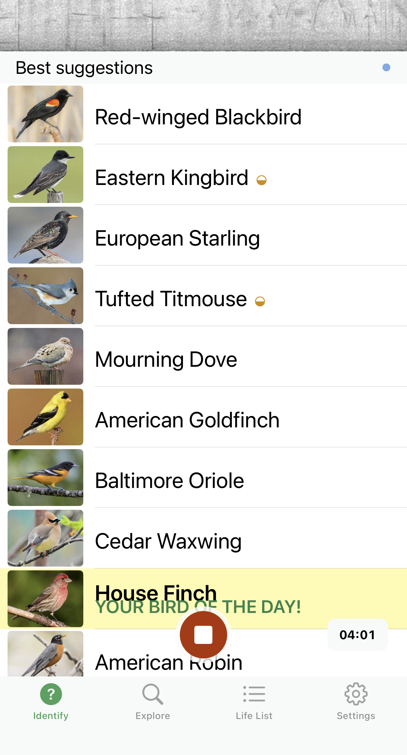

A Metaphor
Notes:
Cornell Lab of Ornithology
If you’re like me, you can probably pick out a blue jay or a cardinal just by listening, but did you even know you might also be hearing a tufted titmouse or a eastern kingbird. This is how I am thinking about ageism and ableism. Among the chorus of messages all around us every day, we can hear the blue jays “move over old lad” on the freeway but we are inundated by titmouses and starlings and waxwing and pretty soon we all believe aging is nothing but a horrible experience.

Slide 7
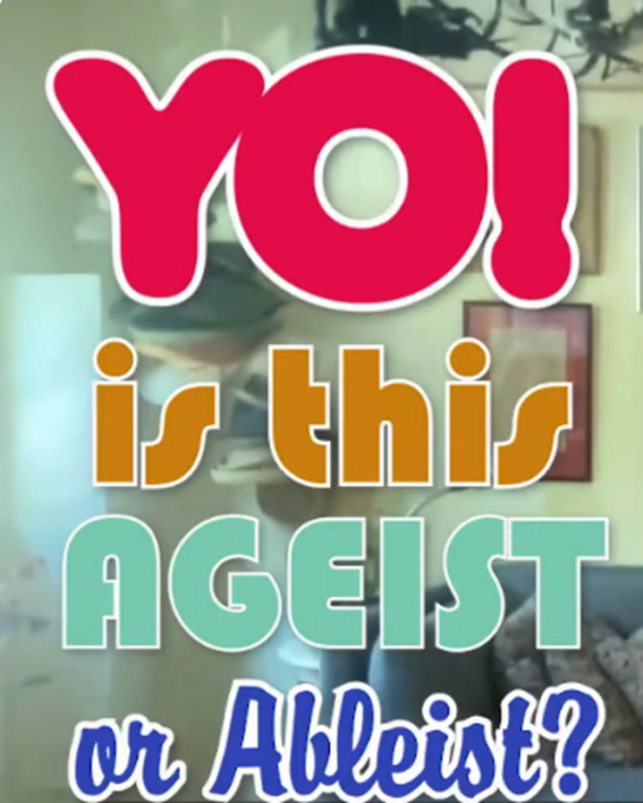
Mix Them Together and What Do You Get?

Slide 8

It’s a Movement!
Our vision is a Wisconsin where everyone, at every age and ability, is respected, valued, supported, and belongs.
Our mission is to advance a fair and complete story about aging and disability: one that values every person, at every stage of life, and every ability. Through reframing our communication and expanding our mindsets, we improve quality of life for all of us.
We are committed to ending ageism and ableism in Wisconsin.

Slide 9



Our Structure
Project management team
Advisory committee
Champions (a great place to join us)
Community of practice

Slide 10
How Ageism and Ableism Show Up
In multiple forms
Stereotypes: How we think
Prejudices: How we feel
Discrimination: How we act
On multiple levels
Interpersonal
Compassionate
Systemic/ Institutional
Self-directed
Information credit: World Health Organization

Slide 11



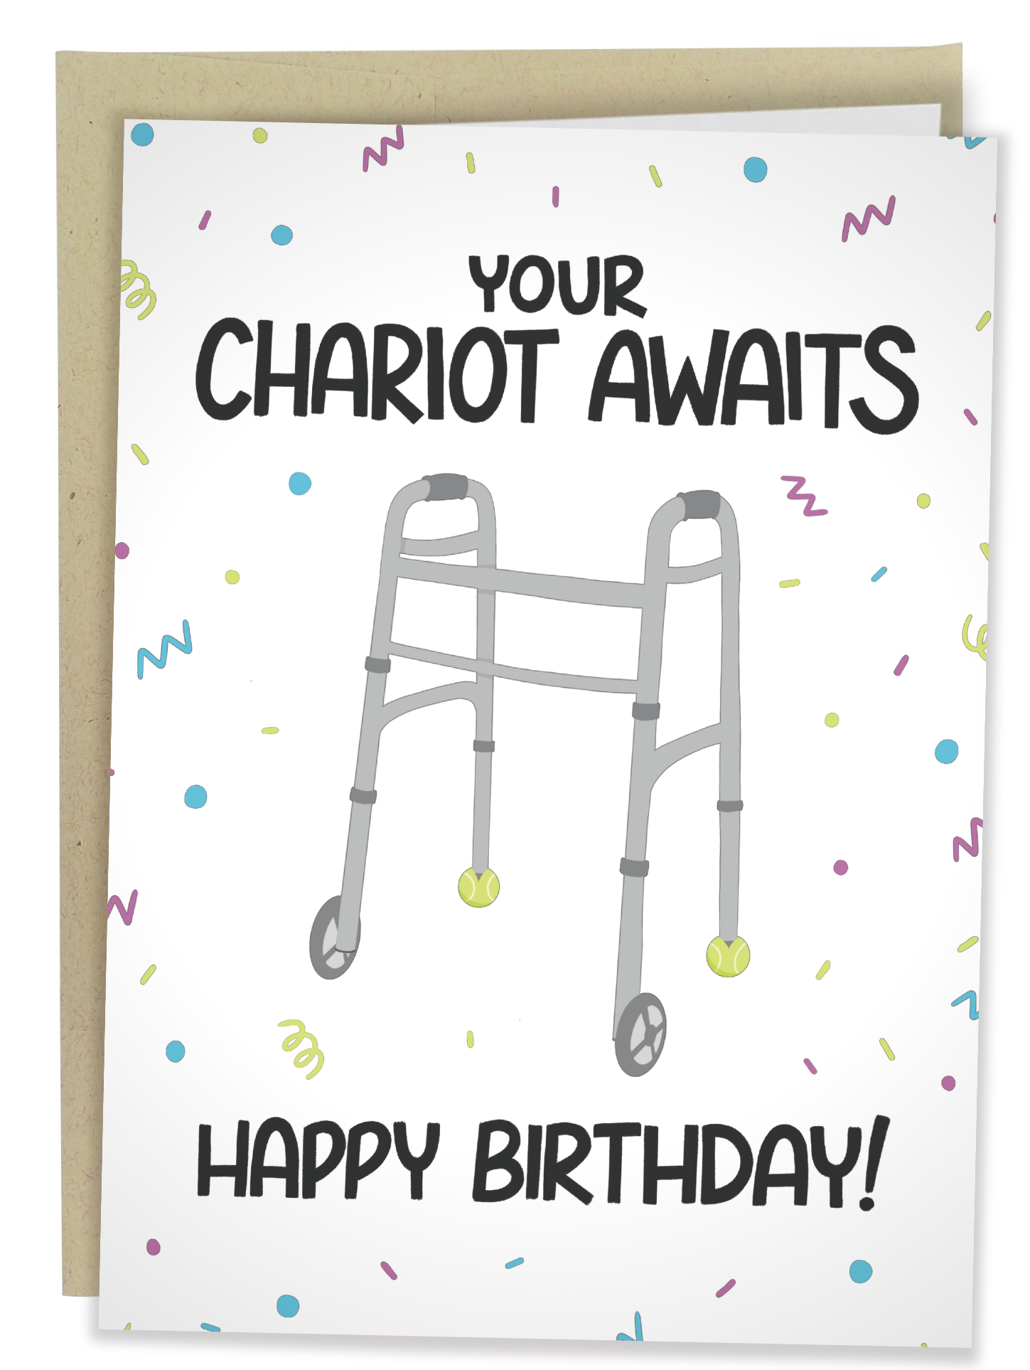


It’s All Around Us

Slide 12
So why do we care?
Those who attribute their ailments to old age, have significantly HIGHER levels of arthritis, hearing loss and heart disease than those who attribute these disabilities to other causes.
Becca Levy, Yale researcher estimates that a positive attitude about aging will add 7.5 years to our lifespan.
People with disabilities who internalize ableism are less likely to seek accommodations, preventive care, or employment opportunities.
When disability is viewed primarily as an individual deficit, rather than a systemic issue, policies and funding often prioritize "fixing" the individuals instead of removing barriers.

Slide 13
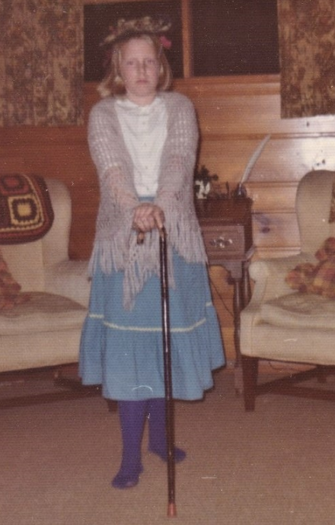
A Place to Start
Implicit bias refers to the attitudes or stereotypes that affect our understanding, actions, and decisions in an unconscious manner.
Simply being aware of our implicit bias reduces the “ism”.
Notes:
(The Kirwan Institute for the Study of Race and Ethnicity)
(Busso et al., 2019)

Slide 14
One Thing Leads to Another
Changing our communications through intentional framing strategies
Changes the way we talk about aging
Which changes our thinking
Which can lead to beneficial policy and systems change.

Slide 15

What Exactly is a Frame?
Cultural mindsets are deep, assumed patterns of thinking that shape how we understand the world and how we make decisions
Framing is about choices to help shift cultural mind sets
What to emphasize
How to explain it
What to leave unsaid

Slide 16
Words Matter
Elderly? Senior?
  Milwaukee County 60+ Leadership Program
Silver Tsunami
If “they” had only saved better…
CNN: Kara Swisher Wants to Live Forever: Swisher investigates the promises and pitfalls of the booming longevity industry.
Notes:
Senior Leadership Program – could be all the executives, 40 year life span
Across the series, Swisher examines everything from anti-aging treatments and biotech breakthroughs to the role of artificial intelligence, the influence of Silicon Valley, and the growing cultural obsession with extending life.

Slide 17
Frames to Advance
Collective Responsibility
Building Momentum
We are all aging!
Aging and disability are experiences that connect us all.
What surrounds us, shapes us.
We all need a variety of support to live and thrive.
Older adults and people with disabilities have unique experiences to offer our communities.
Adults over the age of 60 are living and contributing to their communities longer.
Notes:
Look around the table

Slide 18
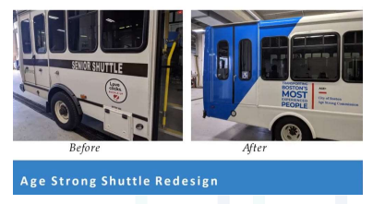
Example 1
“Transporting Boston’s most experienced people.”
Information credit: National Center to Reframe Aging

Slide 19
Frames to Advance 2
Solution Focus
Justice
We can do hard things!
We have solved problems before, and we will solve problems again!
As our population ages, we tap into the innovation and can-do attitude that Wisconsin is known for to address the challenges that come with this changing demographic.
A just society ensures that everyone, regardless of age or ability, can participate and contribute in meaningful ways.
We all have a right to be included in our communities.
Notes:
We just sent a diverse group of astronauts around the dark side of the moon!

Slide 20
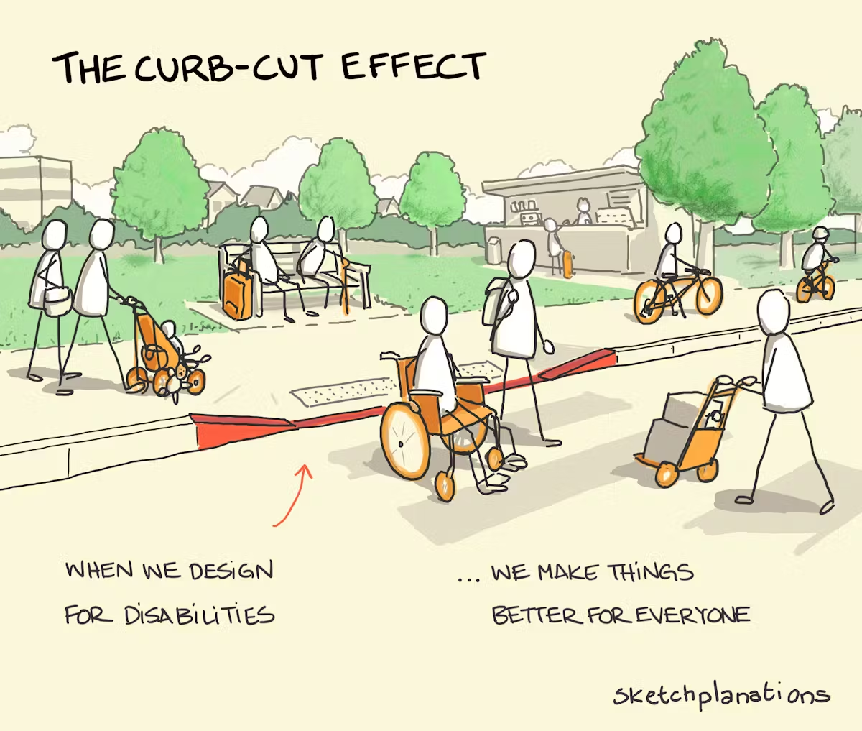
Example 2

Slide 21
Take Aways
Start by:
  Sign Up for the Champion’s List – a monthly newsletter with ongoing training and top of mind opportunities
  Using “we” and “us”
  Picking one frame to incorporate in your daily awareness
Avoid:
  Focusing on individuals
  Vulnerability as an inherent truth for older adults and people with disabilities
  Fatalism

Slide 22
Age and Disability-Friendly Ecosystem
Rowing in the same direction

Slide 23
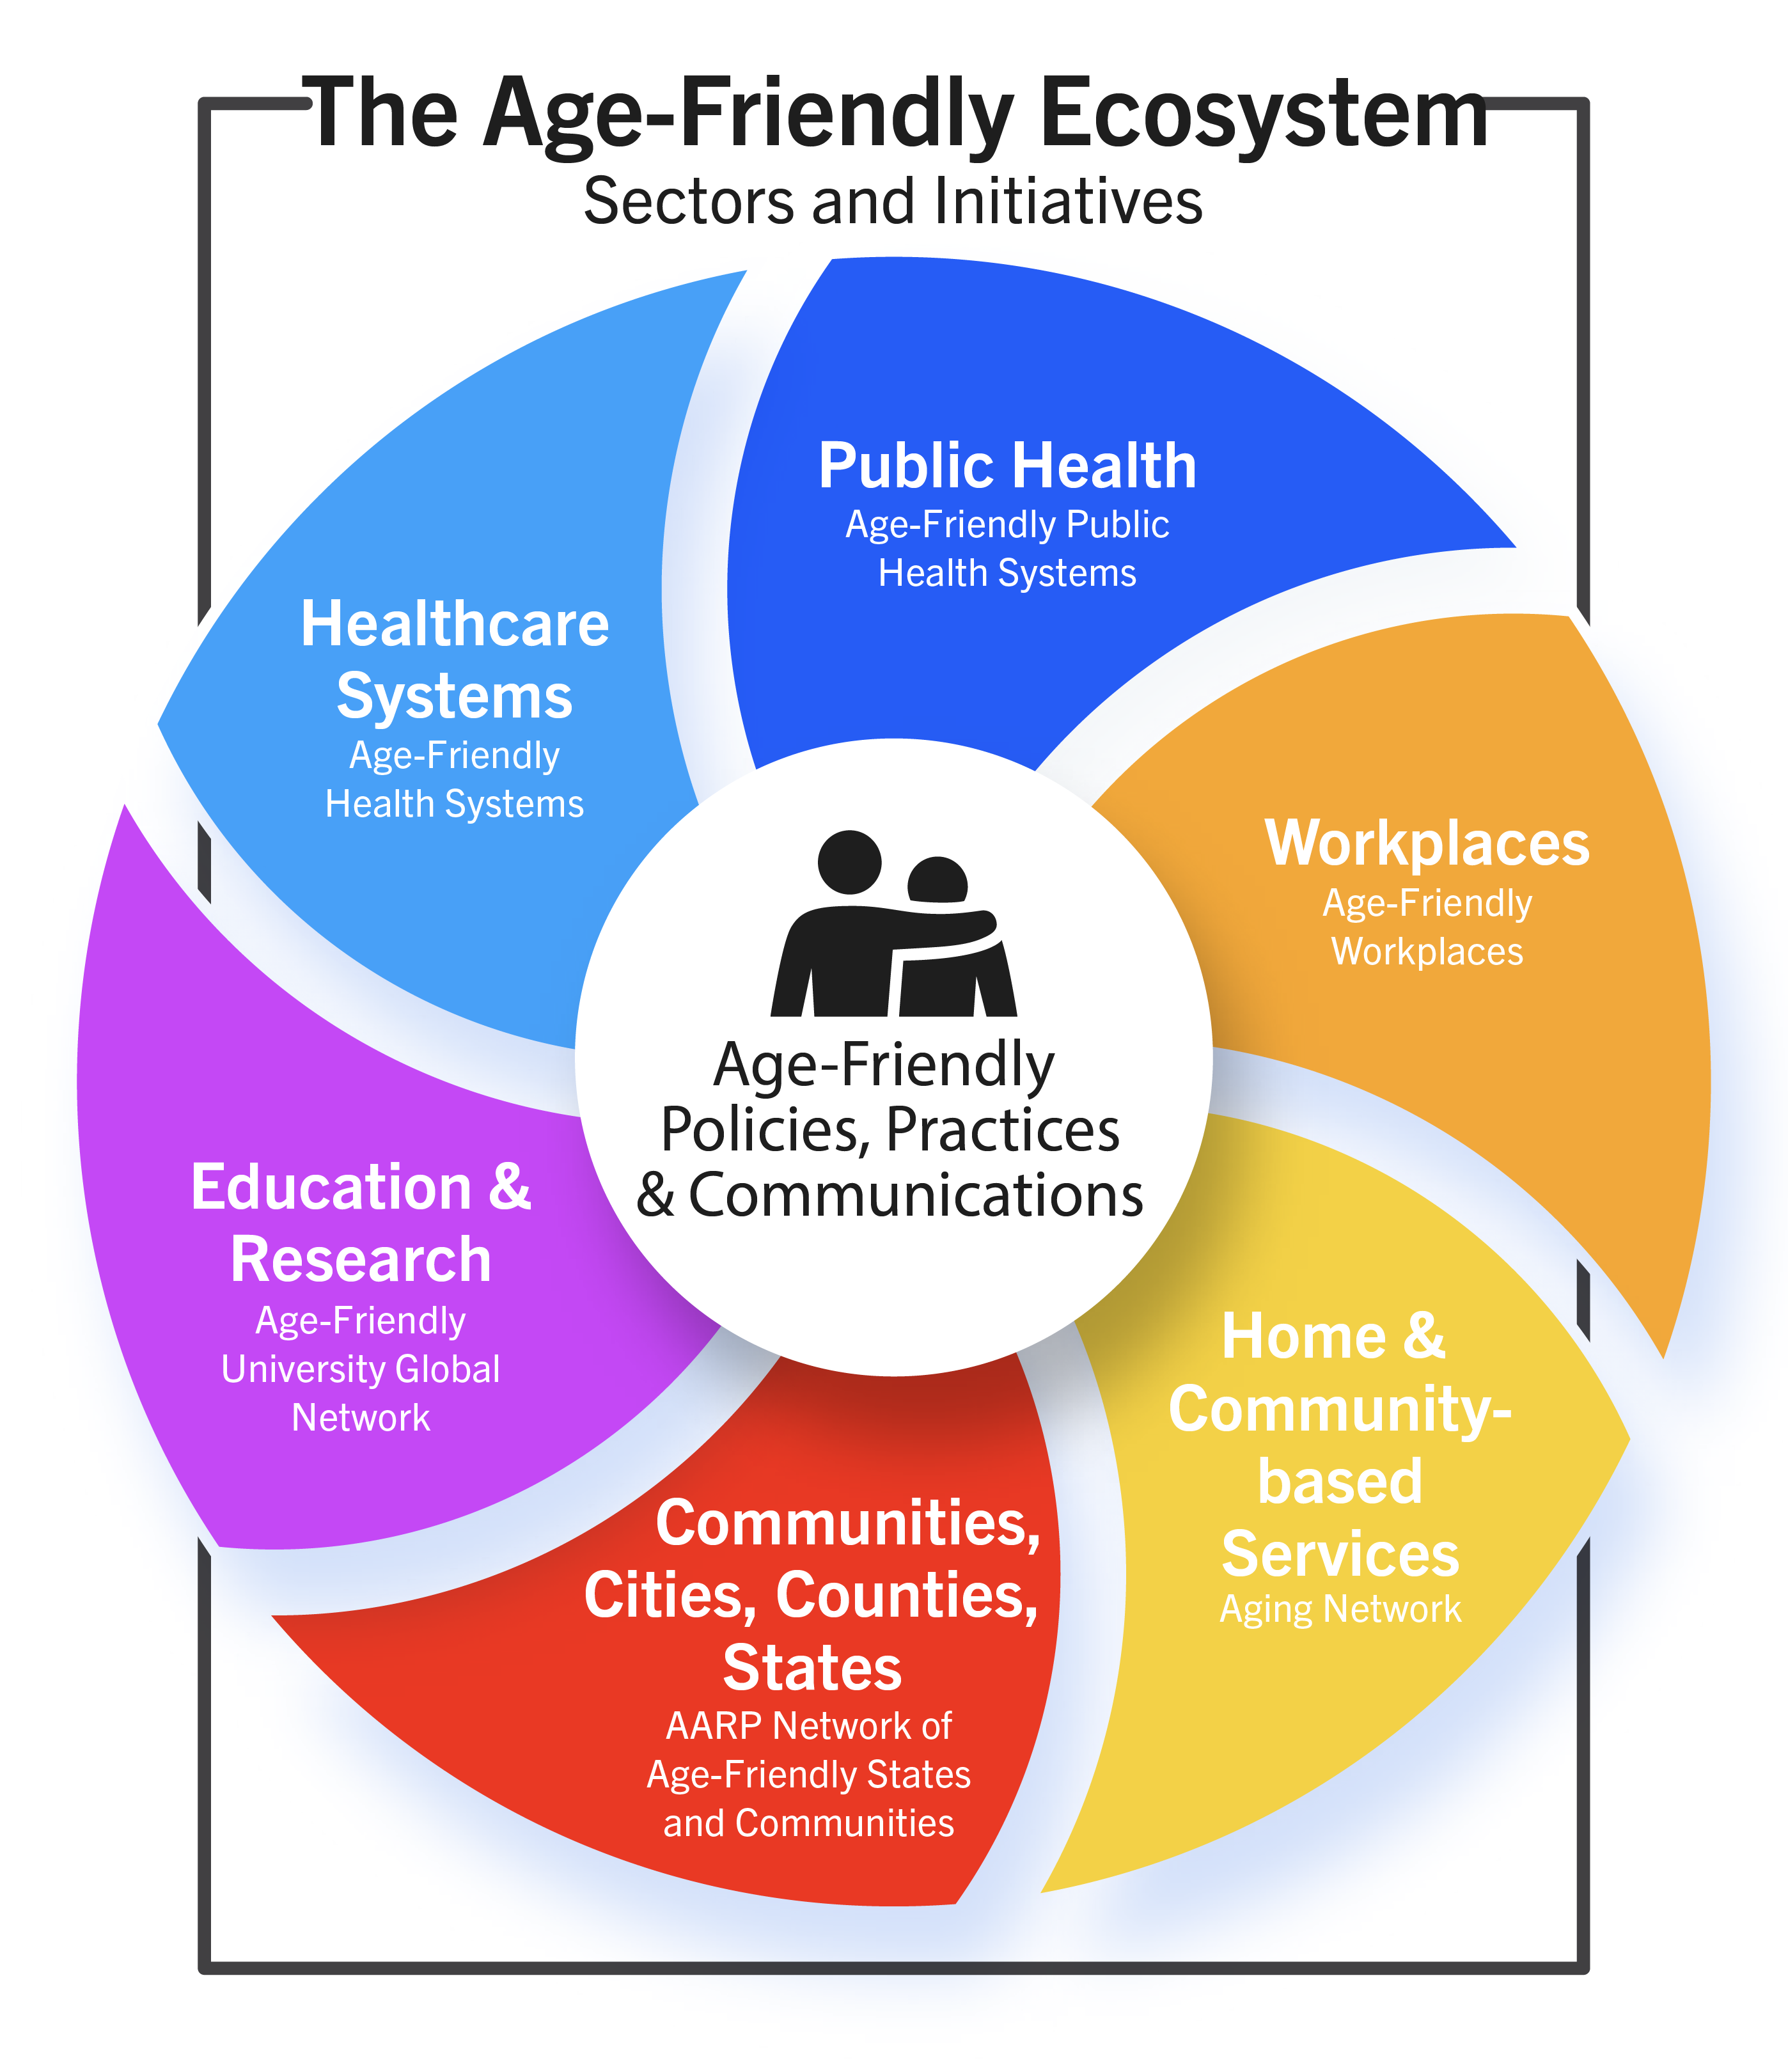
Introducing the Age and Disability-Friendly Ecosystem
2017
2018
After key convenings to align age-friendly stakeholders, the John A. Hartford Foundation established the ecosystem framework in 2020.
Home and Community-based Services has not designation because Medicaid and Older Americans Act services vary widely across the country.
2012
2006
2012
Notes:
History: Multi-sector Plan for Aging (MPA) – governor/legislatively led
We already have Age Friendly designees in the state -

Slide 24
Why?
Our vision is a Wisconsin where people of all abilities belong and can thrive as they age.
Our mission is to build a more inclusive Wisconsin by advancing age and disability friendly practices statewide through cross-sector collaboration.
We are all aging! Total 60+ Population in WI: Approximately 1,514,099 individuals representing 25.6% of the population.
Population health is achieved when everyone has a fair and just opportunity to be as healthy as possible in society. Ageism and ableism create a barrier to this goal.
When we bring people together to work in genuine collaboration, we amplify our power to make systems change.

Slide 25
By Sector
Age-Friendly Universities: UW La Crosse, UW Superior, UW Green Bay
Age-Friendly Communities: Appleton, Greendale, La Crosse, Madison, Milwaukee County, Oshkosh, Reedsburg, Sheboygan, Shorewood, Stevens Point, Sun Prairie, Wausau, Wauwatosa, West Allis, West Bend
Age-Friendly Public Health: Wauwatosa, Greendale, Eau Claire and Waukesha Counties
Age-Friendly Health Systems: 78 designees to date supported by a statewide consortium led by the Wisconsin Geriatric Education Center (WGEC) through Marquette University

Slide 26
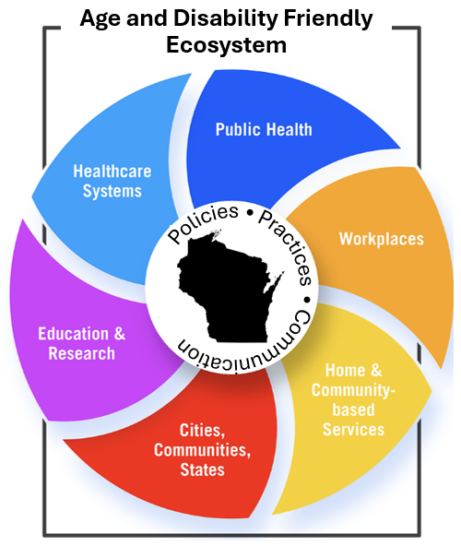
On Wisconsin!
Wisconsin will be the first state in the nation to fully integrate disability into the ecosystem.

