Slide 1

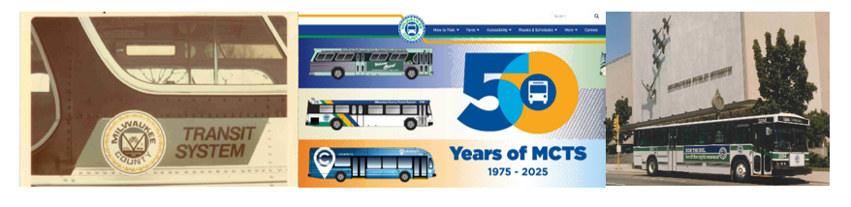
Milwaukee County Transit System Governance:
Opportunities for Enhanced Oversight include Additional Sunlight, Clearly Defined Roles, and Detailed Fiscal Reporting for the Quasi-Governmental Entity
May 2026
MILWAUKEE COUNTY AUDIT SERVICES DIVISION
Jennifer L. Folliard, Director of Audits | Molly Pahl, Deputy Director
MILWAUKEE COUNTY OFFICE OF THE COMPTROLLER
Liz Sumner, Comptroller

Slide 2
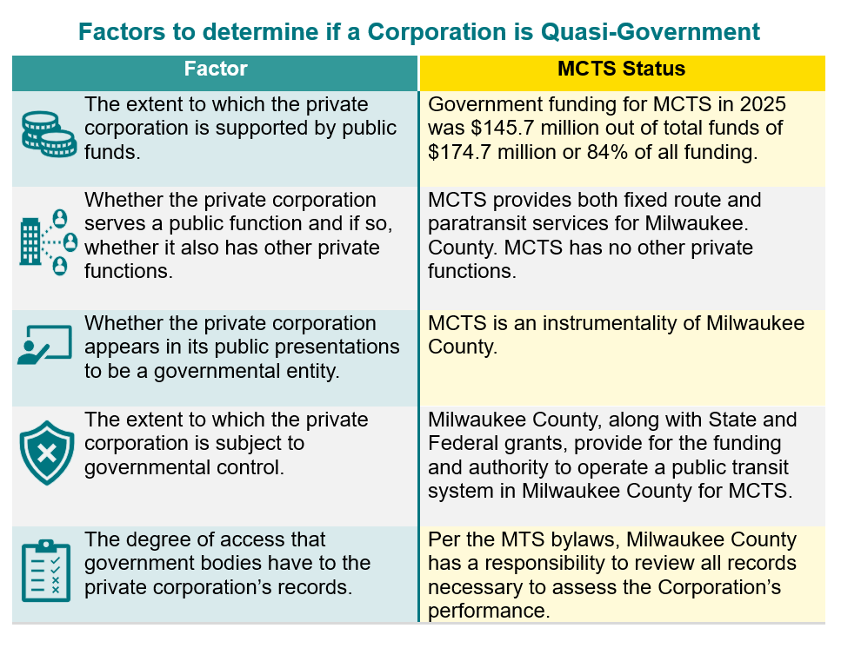

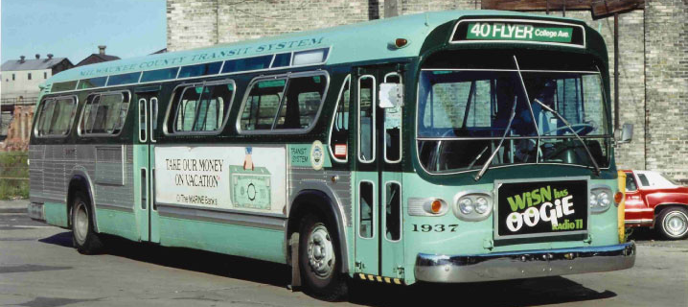
Background
From 1975 to 2014, Milwaukee Transport Services Inc. (MTS), doing business as MCTS, was contracted to be the service provider for transit/paratransit in Milwaukee County. In 2013, the County issued a Request for Proposal to explore other management options but ultimately chose to transition MTS into a quasi-governmental entity which occurred by the end of 2014. An analysis of insourcing vs outsourcing was conducted by a workgroup led by the Comptroller which was presented in February of 2014.
MCTS is not a County department but is an instrumentality of the County and functions as a quasi-government entity. The WI Open Meeting Guide states that an entity is quasi-governmental if it significantly resembles a government in function, effect, or status. The Wisconsin Supreme Court case law notes the factors to use to determine if an entity is quasi-government.

Slide 3
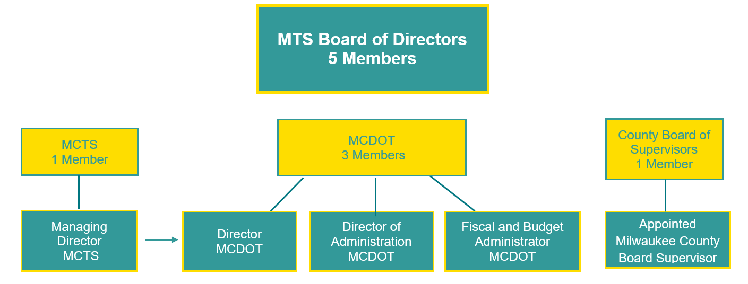
Background
There are three main entities with roles in the provision of transit/paratransit services:
MCDOT - Milwaukee County Department of Transportation which owns buildings and equipment and administers grants.
MTS Board – The Corporate Board of Milwaukee Transport Services, Inc. which is the transit company that oversees business affairs.
MCTS - Milwaukee County Transit System which runs the day-to-day operations of the transit system.
MTS is governed by bylaws established in 1975 and last updated in 2014. Per the MTS bylaws, there are five members of the Board. Four Directors hold their position by virtue of their employment at MCDOT or MCTS with the final Director being appointed by the County Board Chair. Since the Managing Director of MCTS reports to the MCDOT Director, the Board had four members representing MCDOT.
3

Slide 4
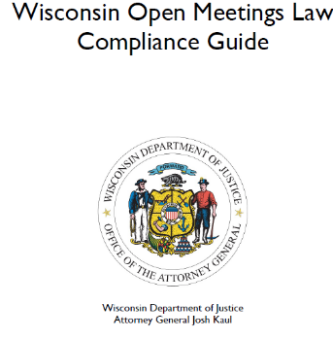
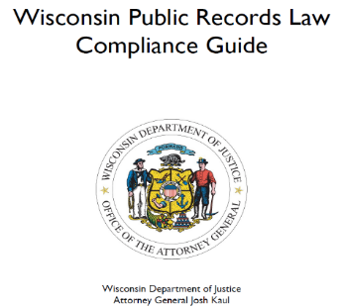

How We Got Here
In June of 2025, a $10.9 million deficit for the County’s transit/paratransit system was announced via a press release surprising many County officials. On June 27, 2025, due to the sudden change in the financial situation, the Milwaukee County Comptroller requested an audit examining the governance and oversight structure.
Our objective was to assess the effectiveness of the current MCTS governance and oversight and to identify any deficiencies with their internal control environment that may impact oversight of the Transit system. The audit was driven by the lack of timely notification of the fiscal deficit and many of our recommendations strive to reduce the recurrence of a future deficit or other significant event unfolding without public sunlight including analyzing whether controls in place within the government structure were adequate.
In addition to a review of MTS’ bylaws, federal regulations, State Statutes, and County Ordinances throughout this audit report, we relied upon a variety of criteria including the Wisconsin Office of the Attorney General guides for Open Meetings and Public Records law along with Robert’s Rules of Order Newly Revised which is a guide for parliamentary procedure that is used by many governing bodies in order to have smooth, orderly, and fairly conducted meetings.

Slide 5
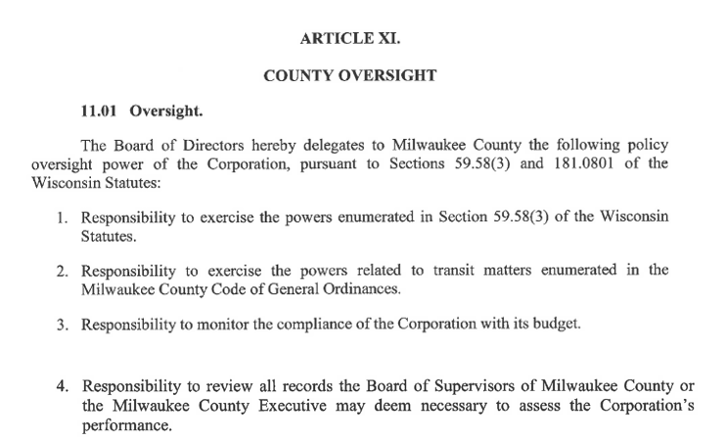
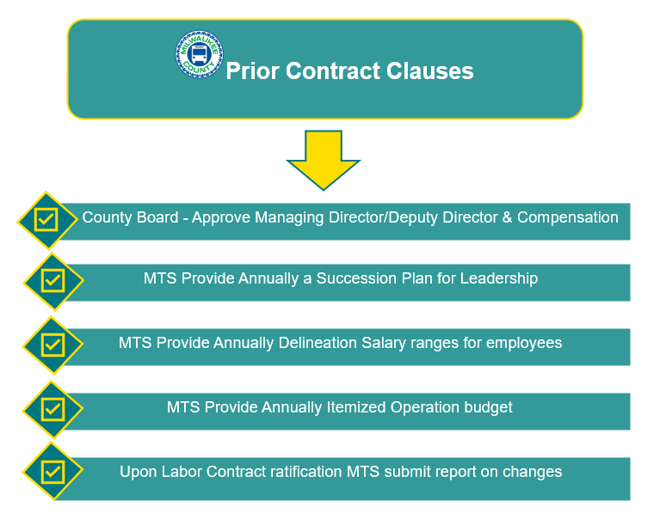
Oversight: County Board, MTS Board, and MCTS
The roles per the Office of Corporation Counsel are that Milwaukee County has oversight for policy and budget issues, while MTS manages business affairs, and the MTS President oversees day-to-day operations. The oversight granted to Milwaukee County within the bylaws are set forth in Article XI of the bylaws.
The final contract the County had with MTS was a two-year contract in 2010 with options to extend until 2014. Several items in the contract required the provision of additional information to the County.
Chapter 1 of the Milwaukee County Ordinances establishes the powers for committees.

Slide 6
Oversight: County Board, MTS Board, and MCTS
Many MCTS items go before County Board committees, but we found during 2020 – 2025, there are a number of items that currently are not reviewed or approved by either the MTS or the County Board.
Items Approved by the County Board
Fares
Routes
Grants
Safety & Security Policies
Budget Adopted and Revision
Capital Improvement Requests
Items Approved by the MTS Board
Self-Insurance
Appointment of MTS Board Officers
Appointments of members to retirement related boards
Signature authority for checks & contracts
Informational Items Reviewed by the County Board
Grant Updates
Strategic Plan Reports
SEWRPC Reports
Project Studies
Taskforce Updates
Employee Engagement Study
EEO Reports
Bus Operator Retention – 2001
Items with no Public Body Review
Procurement including RFPs
Human Resources
Specific Contract Approvals
Employee Benefits
Labor Contracts Approval
Compensation and Merit Increases for Non-Reps
Paratransit Contract Approval
FTA Audits and Triennial Reviews
State of Wisconsin Reviews
6

Slide 7
Oversight: County Board, MTS Board, and MCTS Cont.
At its annual MTS Board meeting, the Directors vote on who at MCTS has the authority to sign contracts and checks. Approval of specific contracts, including significant multi-year agreements, are not done by the MTS Board or the County Board. County rules state that a contract is not subject to County Board review only if it uses funds from already adopted fiscal budgets. MTS has executed multi-year contracts with large future obligations which may be in violation of County policy.
Major Multi-year Contracts Not Approved by MTS or County Board
Type | Cost Estimate | Duration | Total Active
Transdev (Paratransit) | $22.4 million actual in 2025 | 2023-2030 | 1
Union (Labor) | 2025 Actual Operator Salary and Paid Absences Only – $55.7 million | 2025-2028 | 2
While the MTS bylaws state oversight is delegated to Milwaukee County via its power related to transit matters enumerated in its ordinances, MCTS did not have a list of ordinances they follow. A review of the ordinances found only 15 ordinances with the word “transit” providing little guidance to MCTS.

Slide 8
Oversight: County Board, MTS Board, and MCTS
Recommendations
MCDOT should work with OCC to expand and clarify what falls into each category:
-policy and budget issues under the County Board’s purview
-business affairs under the MTS Board’s purview
-day-to-day transit under the MCTS President
1
2
MCDOT should work with the MTS Board and OCC to develop a list of ordinances that apply to MCTS and present the list to the MTS Board and County Board.
3
MCDOT should establish clarity on contract approvals including if County Board approval is required for multi-year contracts entered into by MCTS that create future appropriation obligations for the County.

Slide 9
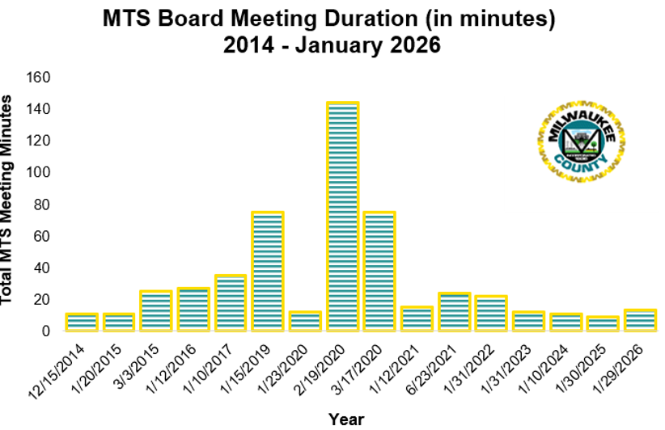
MTS Board Meetings
While MCTS regularly appears before County Board committees, since 2014, the MTS Board met 17 times with a typical agenda listing of five to six items. The last meeting with a duration of over 20 minutes was in 2020. The MTS Board never met to be briefed on the $10.9 million projected deficit in 2025.
The MTS Board at its annual meetings processed the:
Appointment of Officers
Approval of Self-Insurance
Approval of standard business matters
  Approval of MCTS Management representatives on the MCTS Pension Board and 457 Plan Board
  Acknowledgement of MTS officers, managers, and agents to sign orders for the payment of money and contracts
Distribution of MTS Ethics and Conflict of Interest Policy
Approval of prior meetings minutes – typically one year after the meeting occurred
MCDOT should develop policies and procedures on presenting to either the County Board or MTS Board on:
- a periodic detailed financial update on revenues, grants, and expenditures
- a review of any legal issues anticipated to have a significant fiscal impact
- notifications, reports, and status updates on any audits, reviews, or investigations
4

Slide 10
Fiscal Oversight and Representation on the MTS Board
In 2014, the Comptroller explained that all expenses for Transit Operations with the exception of some charges are essentially consolidated into a single expenditure account on the County books. Charges that remain on the County side are debt and depreciation, capital outlay, and crosscharges from other County departments for provision of services.
The largest expenditure categories for the deficit in 2025 were within salaries, fringe benefits, workers’ compensation, and the paratransit contract. These expenditures fall outside of items approved by either the MTS or County Board.
Expenditures Contributing to 2025 Deficit (in millions)
Expenditure Category | Actual | Budget | Variance
Operator Wages | $49.8 | $47.1 | ($2.8)
Other Salaries & Wages | $24.9 | $23.5 | ($1.4)
Fringe Benefits | $33.0 | $30.9 | ($2.1)
Purchased Transportation Expense (Paratransit) | $22.4 | $19.8 | ($2.6)
Workers’ Compensation | $6.0 | $4.0 | ($1.9)

Slide 11
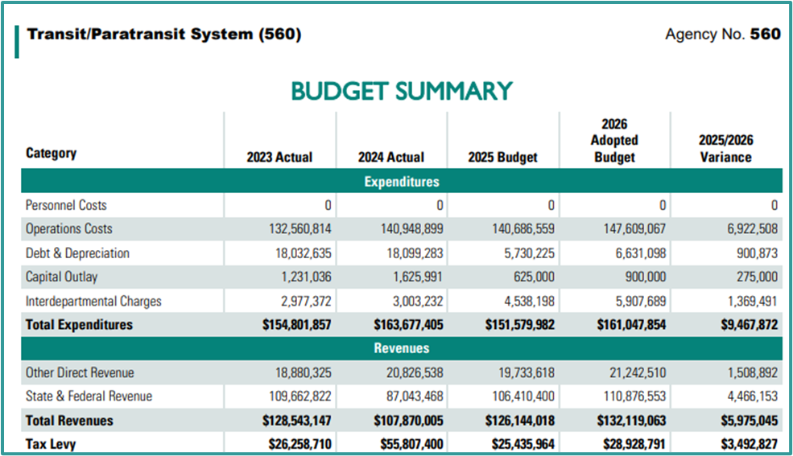
Fiscal Oversight and Representation on the MTS Board
Due to the unique funding structure for MCTS, it is difficult to analyze their finances. There is no representation from other County financial stakeholders on the Board of Directors.
Historically, the funding structure for MCTS has been split with some expenses paid by the County and the remaining costs managed by MCTS. Property tax levy and Vehicle Registration Fees are also split. Vehicle registration Fees are a part of Other Direct Revenue.
Split of 2025 Adopted Expenditures between MCDOT and MCTS
Expenditure Category | MCDOT | MCTS | Combined
Personnel Costs | $0 | $0 | $0
Operations Costs | $571,217 | $140,115,342 | $140,686,559
Debt and Depreciation | $5,730,225 | $0 | $5,730,225
Capital Outlay | $625,000 | $0 | $625,000
Interdepartmental Charges | $4,538,198 | $0 | $4,538,198
Total Expenditures | $11,464,640 | $140,115,342 | $151,579,982
Split of 2025 Adopted County Based Revenues between MCDOT and MCTS
Revenue Category | MCDOT | MCTS | Combined
Property Tax levy | $8,626,245 | $16,809,719 | $25,435,964
Vehicle Registration Fees | $2,838,395 | $13,361,605 | $16,200,000
Total Revenue | $11,464,640 | $30,171,324 | $41,635,964

Slide 12
Fiscal Oversight and Representation on the MTS Board Cont.
Since passenger revenue is collected by MCTS, the County’s total expenditures for MCTS are reduced equal to the amount of anticipated fixed route revenue. This does not lend itself to easy monitoring of MCTS fiscal areas.
The breakdown of the revenues within the expenditure abatement totaled $26.5 million in 2025 and are based upon fixed route paid fares, fixed route organization paid fares and other fixed route revenues.
Total Operations Budget Revenues in Expenditure Abatement for 2025
Fixed Route Passenger Paid Fares | $17,334,862
Fixed Route Organization Paid Fares - UPass, School Pass, Etc. | $7,277,913
Aux funds, Other Agency, Recoveries | $1,877,650
Fixed Route Operations Revenue collected and recorded by MCTS | $26,490,425
To calculate the total budgeted expenditures for the transit/paratransit system, the amount of fixed route revenue projected to be collected by MCTS must be added to the total expenditures listed in the Adopted Budget narrative. This calculation results in total expenditures in 2025 of $178.1 million versus the $151.6 million in the narrative and in 2026 total expenditures of $192.4 million versus the $161.0 million included in the narrative.
Total Expenditures for Transit/Paratransit
Category | 2025 Budget | 2026 Budget
Total Expenditures from Adopted Budget Narrative | $151,579,982 | $161,047,854
Total Operating Revenue in Expenditure Abatement | $26,490,425 | $31,394,744
Grand Total Expenditures | $178,070,407 | $192,442,596
12

Slide 13
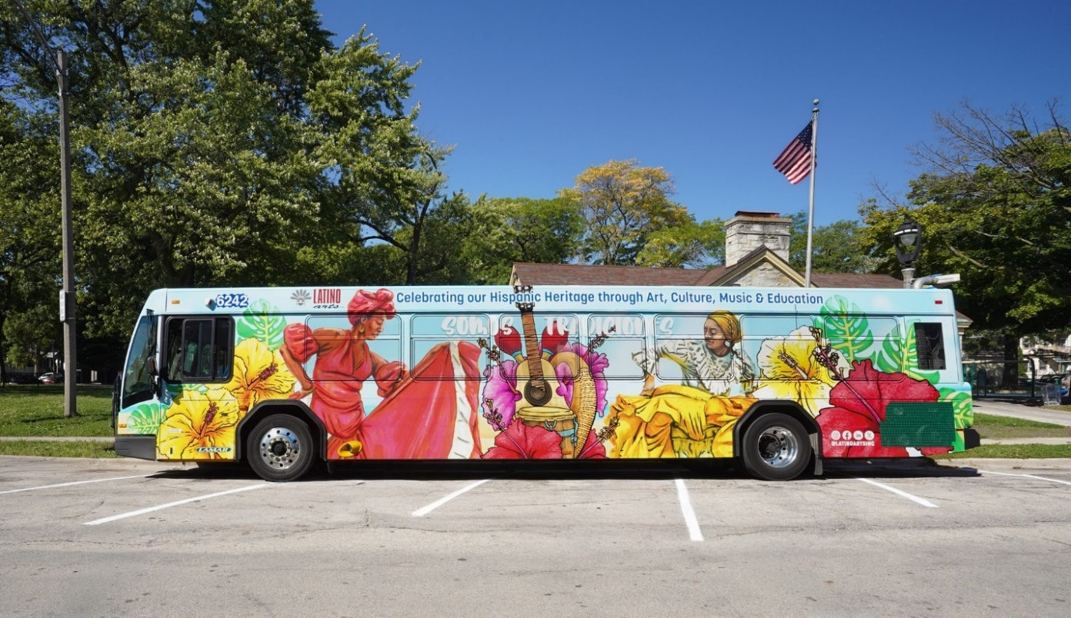
Fiscal Oversight and Representation on the MTS Board Cont.
MCTS provided us with a year-end fiscal report for 2025 that included its budget categories for expenses and revenues. This is additional detail than what was provided in the 2025 Adopted Budget for Milwaukee County. The Adopted Budget does not provide cost estimates by routes but often amendments to restore services do. MCTS does not provide details on its staffing in its Adopted Budget narrative.
MCTS does not have reserve funds to defray its deficits. The County is obligated to fulfill any year end deficit for MCTS. In 2025, to fix the projected deficit, MCTS and MCDOT requested the County Board approve the use of $9.1 million in funds that had been anticipated for the 2027 budget. This action has had a subsequent impact to the 2027 budget request for MCTS. County financial stakeholders are not represented on the MTS Board of Directors. To add members the bylaws need to be amended and approval obtained from the FTA.
According to interviews, the Directors of the Board from MCDOT and MCTS meet often, which lessens the need for board meetings, however, that practice might be in violation of the Wisconsin Open Meetings law. Due to the size and makeup of the MTS Board, quorums may occur when meetings between MCDOT and MCTS staff take place.

Slide 14
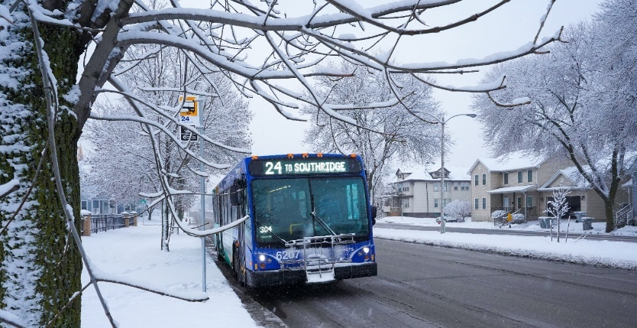
Fiscal Oversight and Representation on the MTS Board Recommendations
5
The MTS Board should consider modifying the makeup of the MTS Board and seek FTA approval if necessary.
6
In the interim, MCDOT should work with OCC to establish written guidance to develop communication procedures that are in compliance with Open Meetings Law to avoid unintentional quorums.
MCDOT should include additional details in its budget narrative for Transit/Paratransit including a crosswalk between the County’s adopted budget and MCTS’s system. Personnel data should also be included such as full-time equivalents, overtime budgets, salary increases and other items to align with information provided by other entities receiving County funding.
7

Slide 15
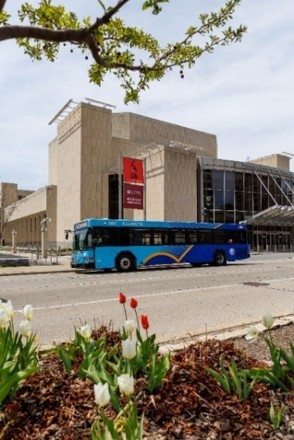


MTS Board Rules of Order Recommendations
Unlike most organizations, the MTS Board does not have a supplemental guide to its bylaws and does not identify its parliamentary process. A clause was added to the bylaws in 2014 that the MTS Board must comply with the State of Wisconsin Open Meetings and Public Records Law.
Chapter 1 of the Milwaukee County Code of Ordinances establishes the County Board proceedings. The County also has an Administrative Manual of Operating Procedures that further details compliance with open meetings.
The MTS Board should work with outside legal counsel to develop rules of order and other directions that align with the provisions of the Bylaws and that provide guidance to MTS Board Directors.
8
The MTS Board should determine, vote, and publish their rules regarding the allowance for public testimony at their meetings.
10
The MTS Board should determine if the bylaws need revisions to include a reference to the rules of order and a selection of a parliamentary procedure to follow.
9
The MTS Board should provide copies of the rules of order to all current Board Directors and establish a written onboarding plan when new directors join the MTS Board.
11
15

Slide 16
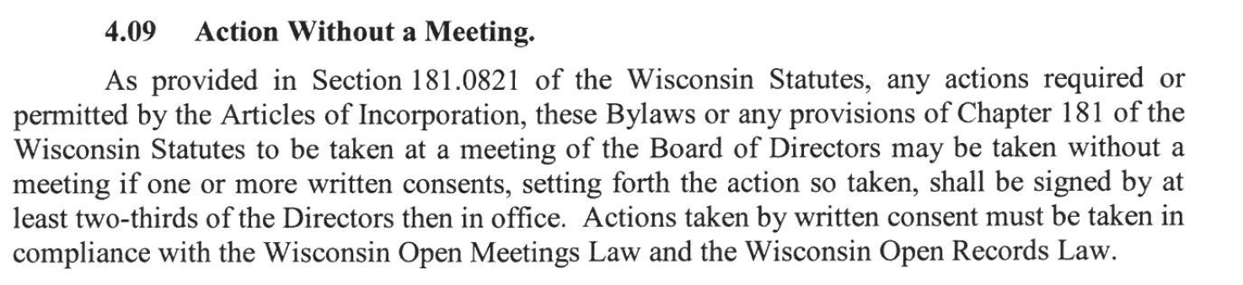
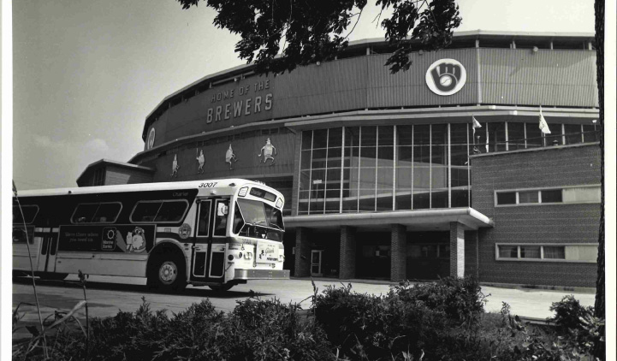
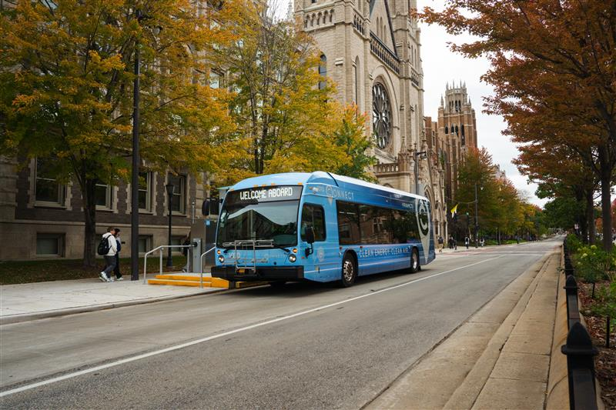
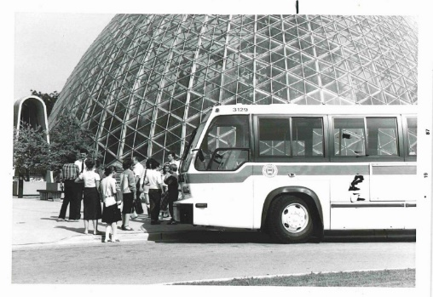
MTS Board Open Meetings, Public Notice, and Actions Without a Meeting
From 2015 to 2025, we found evidence that eight votes took place by the MTS Board without a meeting. The bylaws appear to have conflicting rules regarding whether this type of action is allowed.
16

Slide 17
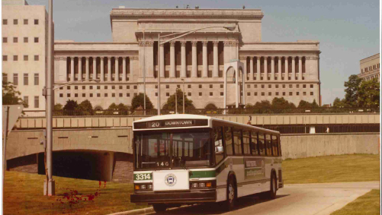
MTS Board Open Meetings, Public Notice, and Actions Without a Meeting Recommendations
The MTS Board should obtain a written outside legal opinion on the apparent conflict found in the bylaws allowing Actions Without a Meeting and the requirement to follow WI Open Meetings Law.
14
12
If Actions Without Meetings are allowed, the MTS Board should include in the rules of order a detailed guide on proper record retention by the MTS Board and MCTS.
If it is determined Actions Without Meetings are allowable, the MTS Board should consult necessary parties to include within the rules of order which votes are allowed and the processes to hold the vote in accordance with state statute.
13
17

Slide 18

MTS Board Meetings Online Availability
Prior to 2025, the MTS Board did not use the web portal County Legislative Information Center or another electronic means to post notices, agendas, packets or minutes from their meetings. Minutes are not approved until the next annual meeting.
Out of the other transit agencies we reviewed, all these elements were posted online and most had archived video.
Website Availability of Notices, Agendas, Minutes, and Archived Video
Transit System | Notices? | Agendas? | Minutes? | Archived Video?
MTS 2014-2024 | No | No | No | No
MTS 2025 | Yes | Yes | No | No
MTS 2026 | Yes | Yes | Yes | No
Indianapolis | Yes | Yes | Yes | Yes
Madison Metro | Yes | Yes | Yes | Yes
Green Bay | Yes | Yes | Yes | No
Minnesota Valley | Yes | Yes | Yes | No
Waukesha Metro | Yes | Yes | Yes | Yes
Cleveland | Yes | Yes | Yes | Yes
Chicago | Yes | Yes | Yes | Yes
The MTS Board should develop and vote to use CLIC or an alternative to enable the public access to meeting notices, agendas, minutes, and an opportunity to attend both in person and remotely. The ability to allow access to archived video or audio should also be explored.
15
18

Slide 19

Milwaukee County Transit System Governance:
Opportunities for Enhanced Oversight include Additional Sunlight,
Clearly Defined Roles, and Detailed Fiscal Reporting for the Quasi-Governmental Entity
May 2026
Project Staff
Audit Team
Candice Lindstrom
Isaiah Garcia-Morton
Sandra Swan
Tevin Roundtree
Isis Williams
Review Staff
Paul Grant, CPA
Bruce Landrum, Jr.
Administrative Staff
Cheryl A. Hosp

