Slide 1
2025 MCDOT
Annual Board Report
Joe Lamers
Director
Reminder to record!

Slide 2
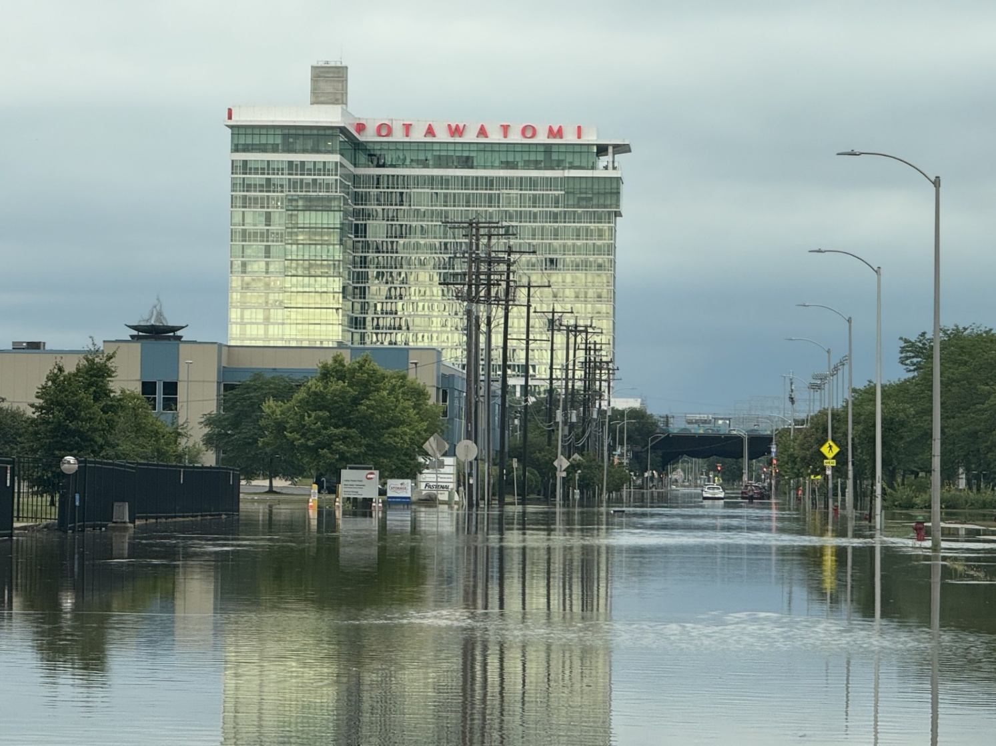
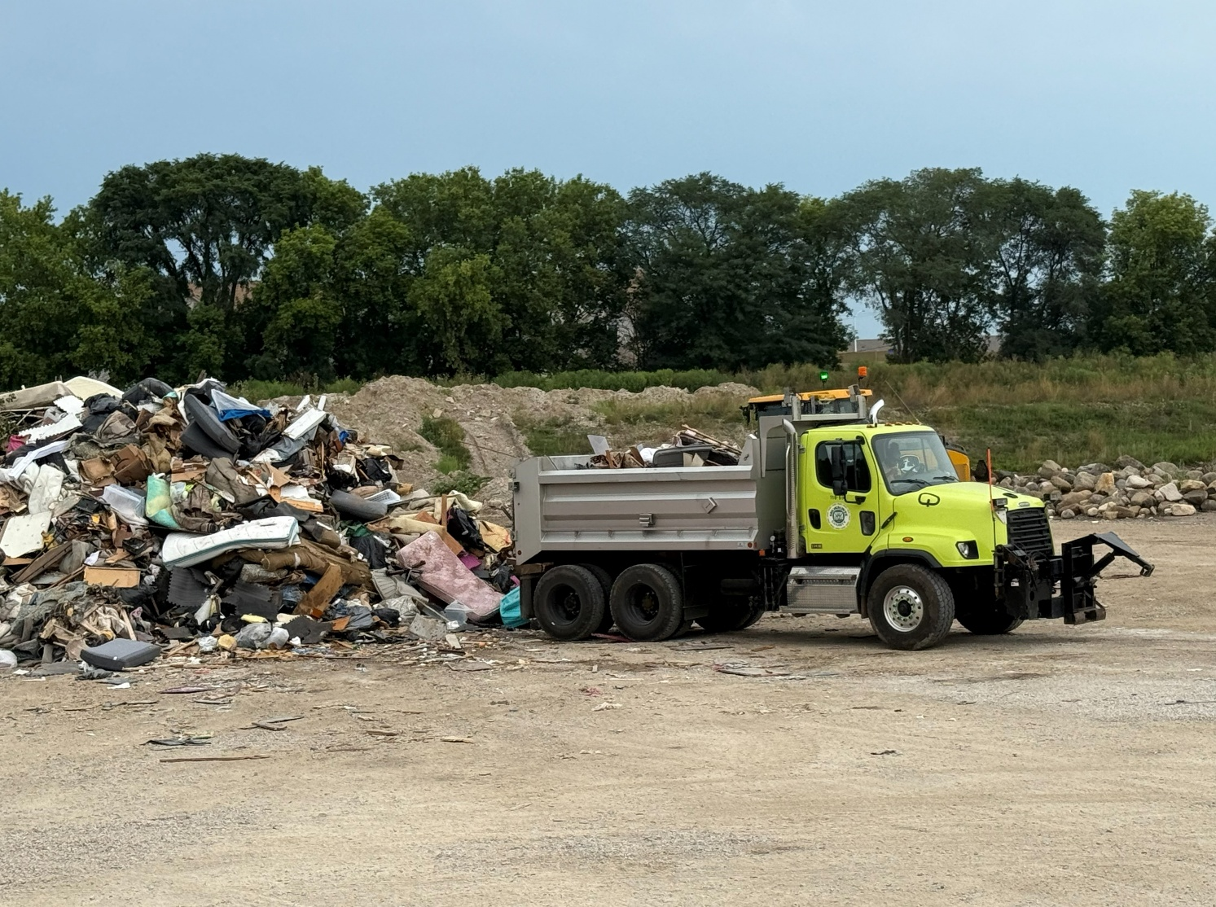
August 2025 Flood Recovery Efforts
VISION ZERO COMMITMENT
SAFER STREETS ROADSHOW

Slide 3
Secured $57M in Non-Traditional Funding in 2025
$25M – USDOT SS4A Grant to deliver 67 traffic safety projects along 10 of the County’s most hazardous roadways
$21M - USDOT BUILD Grant to enhance rider experience and improve transit operations along the PurpleLine corridor
Nearly $8 million CMAQ Grant to optimize downtown transit service, upgrade MCTS’ fleet, and support rider education
$3 million City of Greenfield local funding to reconstruct a half-mile segment of W. Layton Avenue

Slide 4

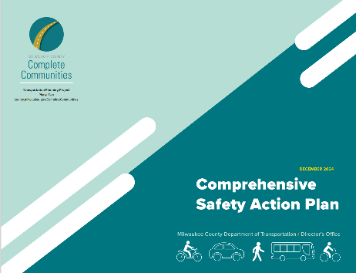
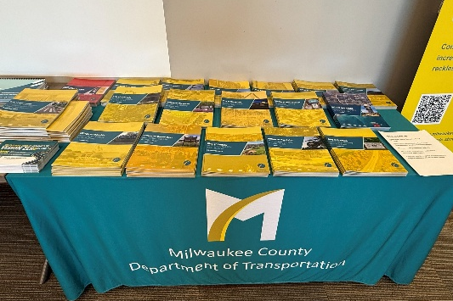
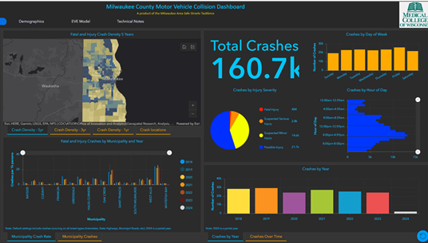
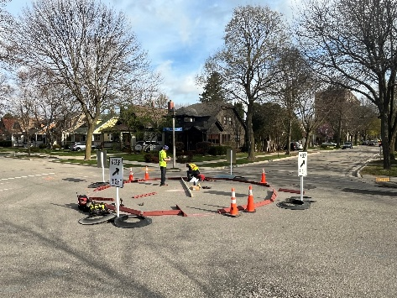
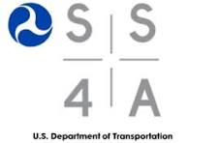
Moving Toward Vision Zero
COMPREHENSIVE SAFETY
ACTION PLAN
MUNICIPAL SAFETY
ACTION PLANS
TRANSPORTATION PLANNING PROJECT
MOTOR VEHICLE COLLISION
DASHBOARD PHASE 2
DEMONSTRATION ACTIVITIES
2025 SS4A
GRANT AWARD

Slide 5
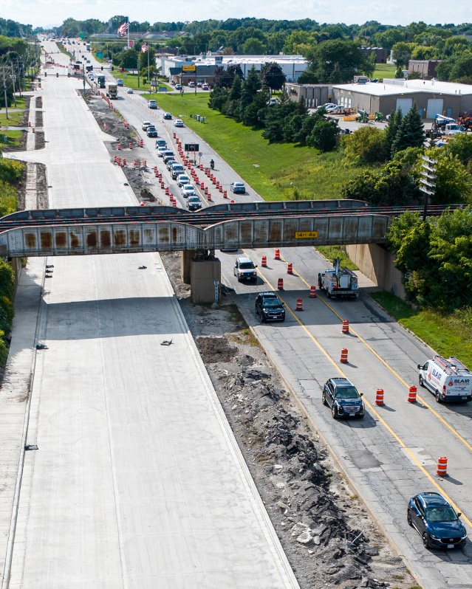
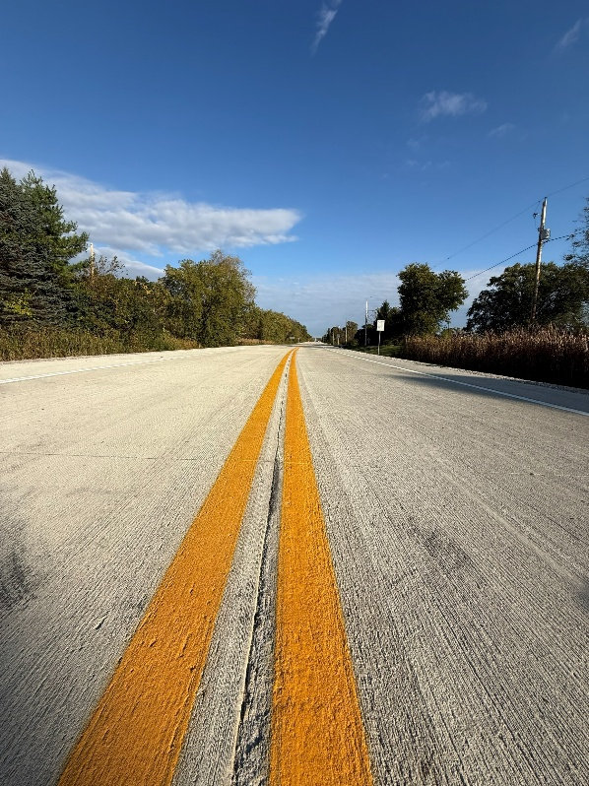
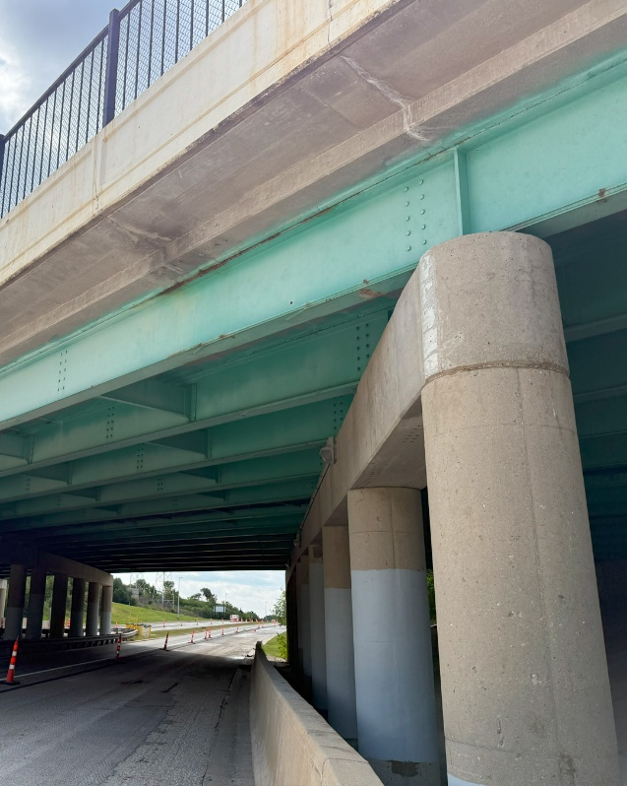
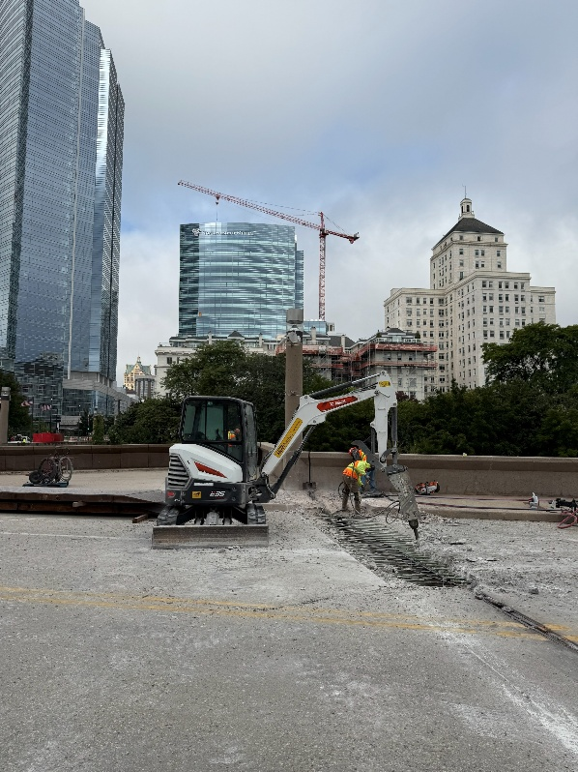
Multimodal Safety, Accessibility, Efficiency
Substantially completed 8 projects along CTH system
  Two roadway, two bridge, and four traffic signal safety improvement projects
W Rawson Ave
(CTH BB)
S 76th St (CTH U)
S 76th St (CTH U) Bridge
E Mason St Bridge

Slide 6
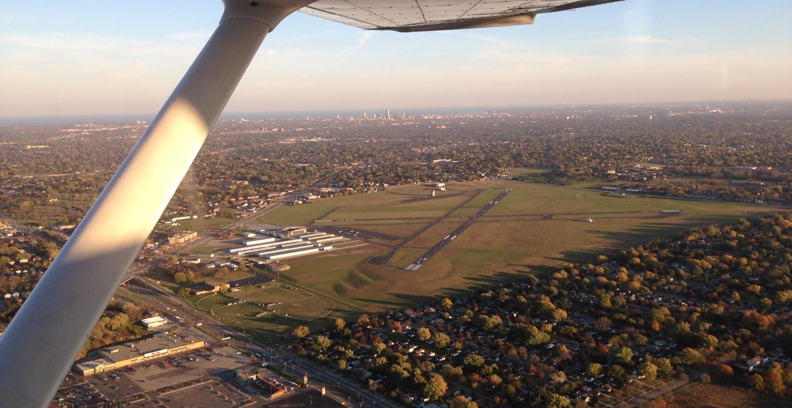

Airport
Broke ground on MKE Air Cargo Center (completion 2026)
Launched Concourse E Redevelopment
Expanded concessions on Concourse D
Introduced Make‑A‑Wish Kids Zones
Hosted MPS ACE interns and Girls in Aviation Day.
Held two pilot competitions at Timmerman Airport
Participated in Airport Workers Day and
Launched centennial branding
Supported airport hiring event with MCDOT
Added Where We Fly online route module
Released third Now Boarding magazine.
Earned “Best Way to Get Out of Town” award.

Slide 7
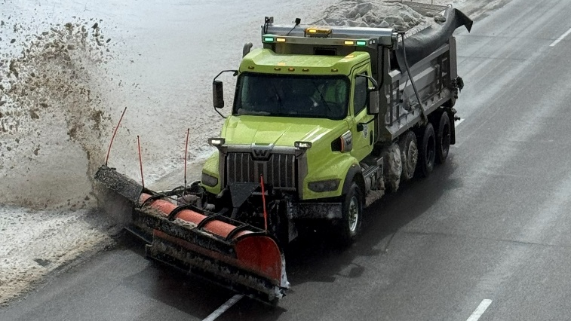
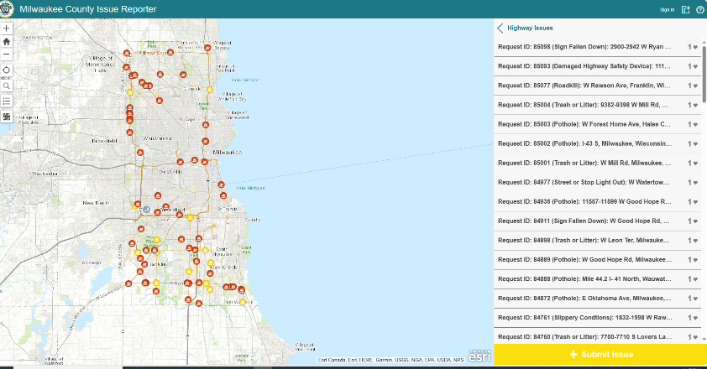
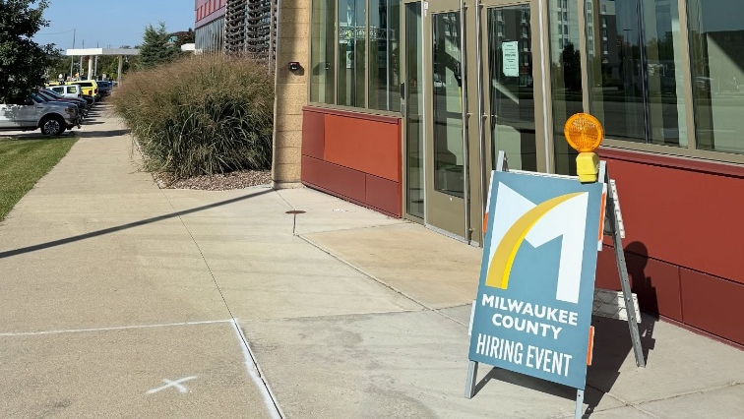
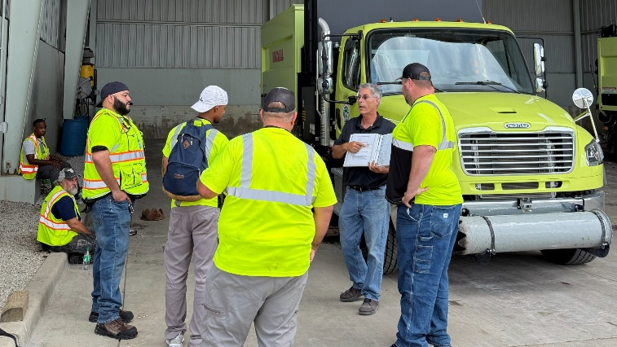
Highway Maintenance
Focus on Fiscal Health
More than $15m in RMA
$1.9m in DMAs
Increased salt brine use
Increased Citizen Issue/Reporter Use
Increased Recruitment/Retention
Innovative Training & Development

Slide 8
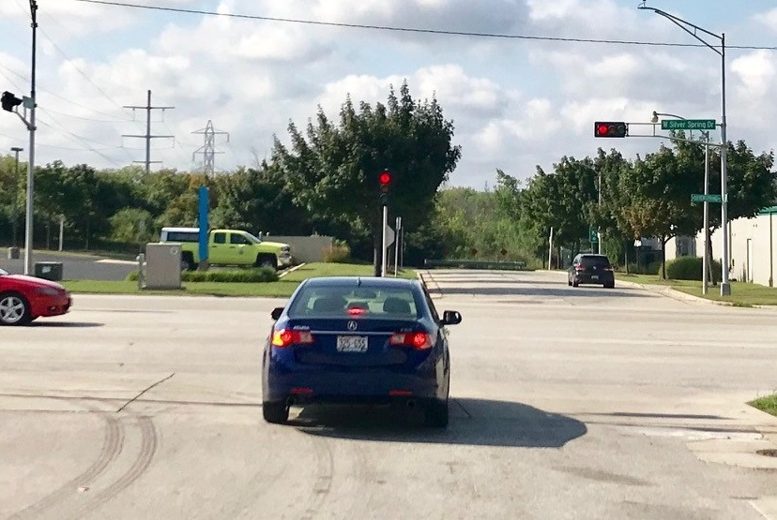
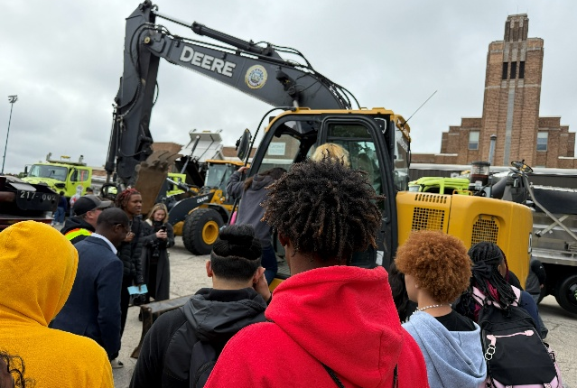
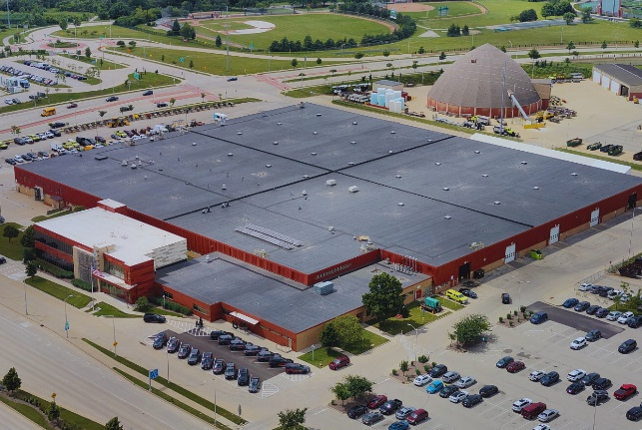
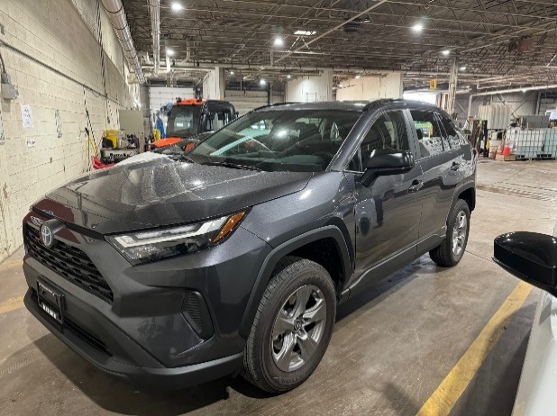
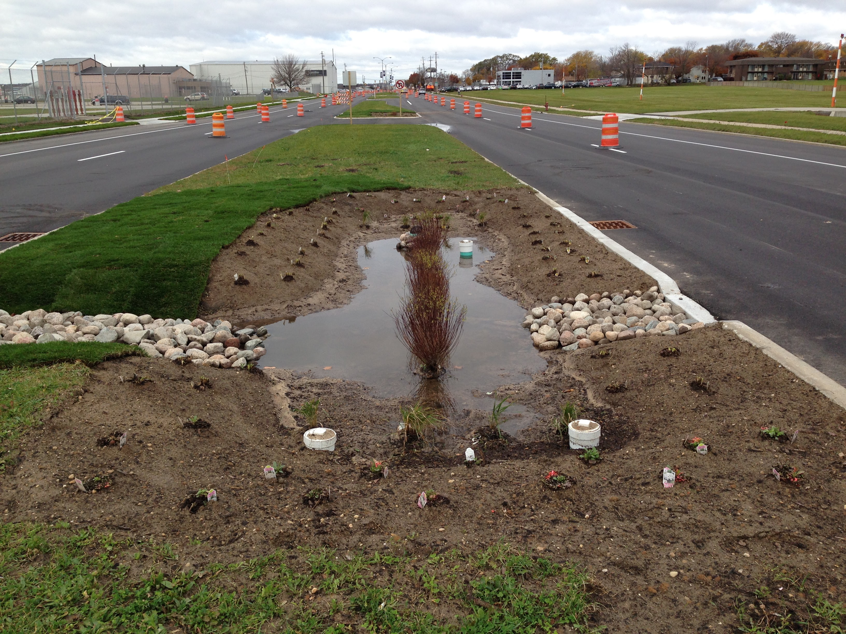
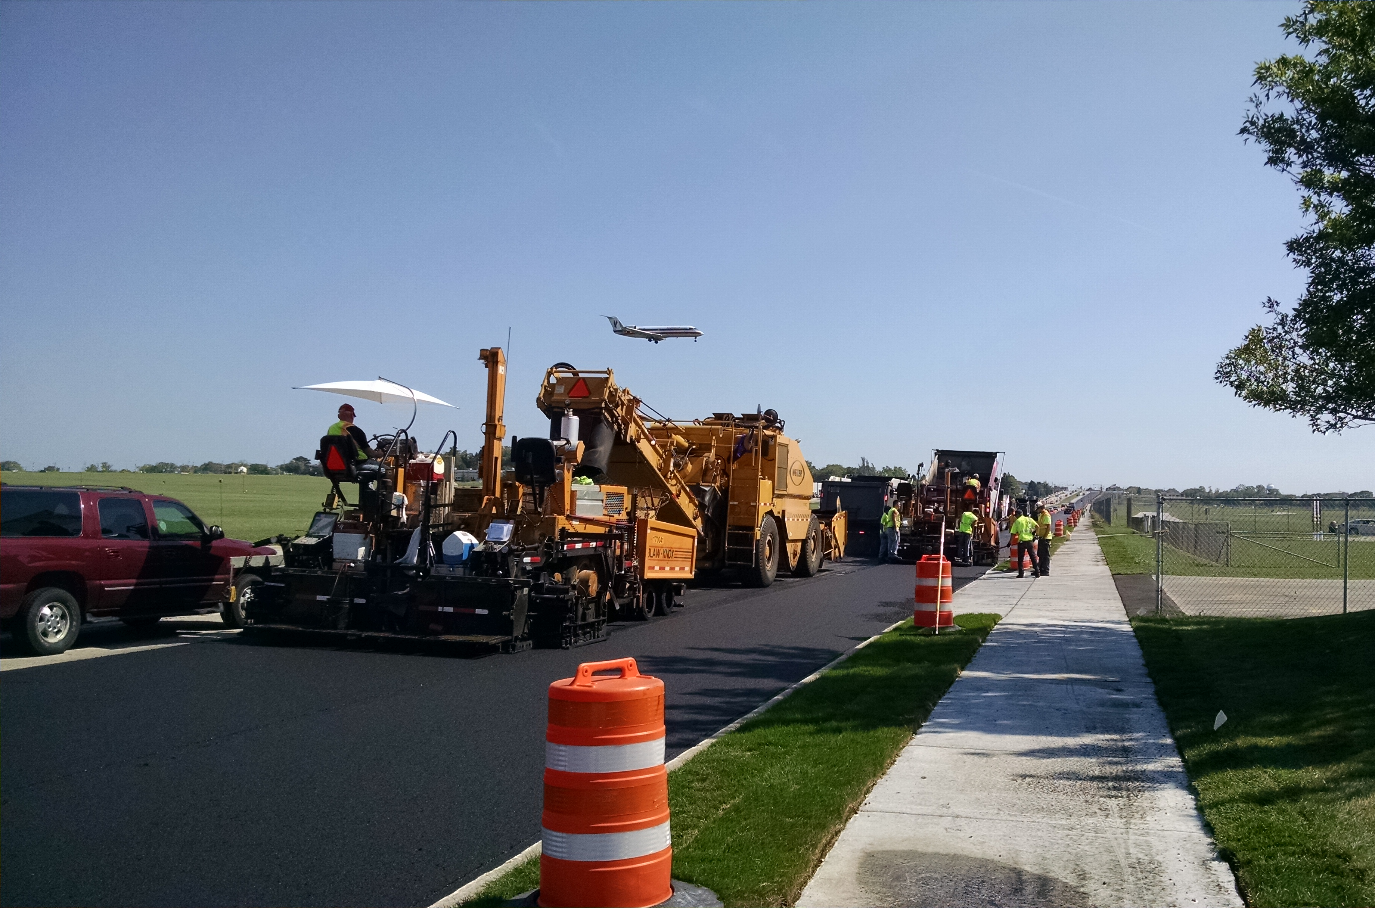
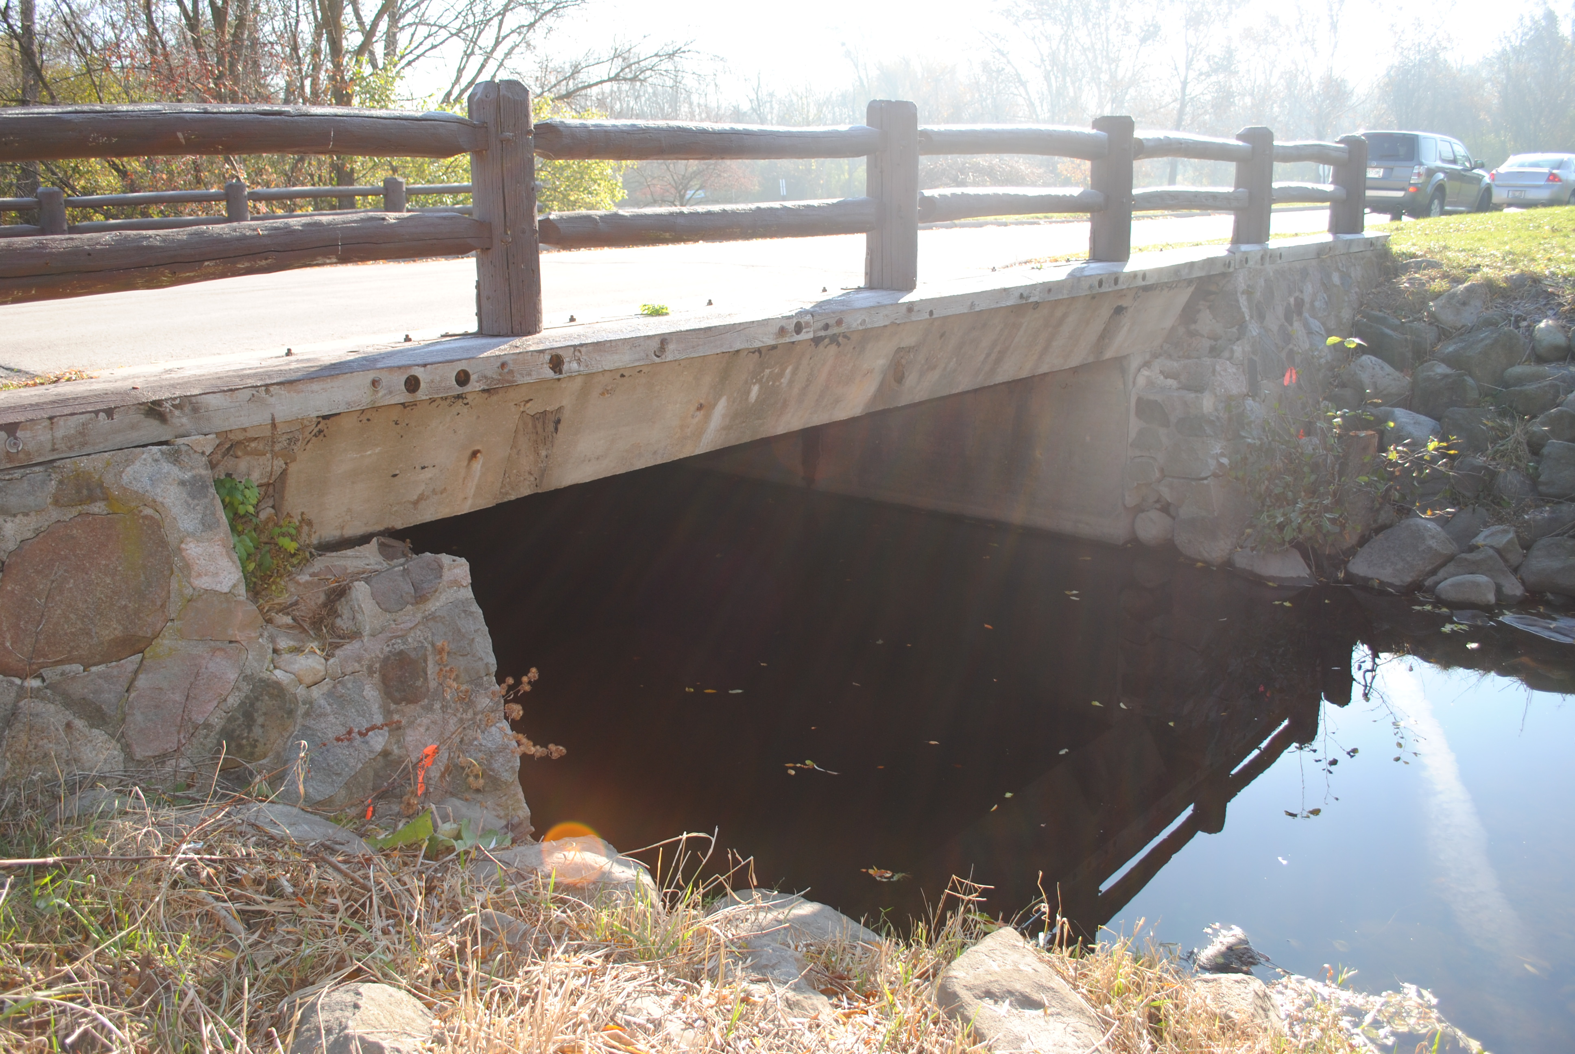
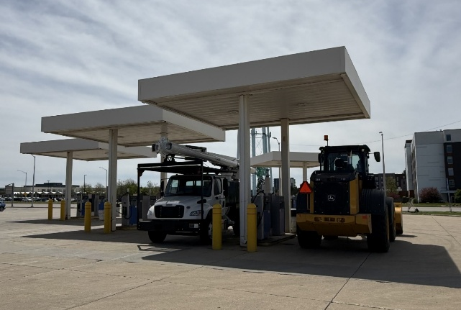
Fleet Management
Fleet Optimization
Sustainability Initiatives
Recruitment and Retention
Facility Efficiency

Slide 9
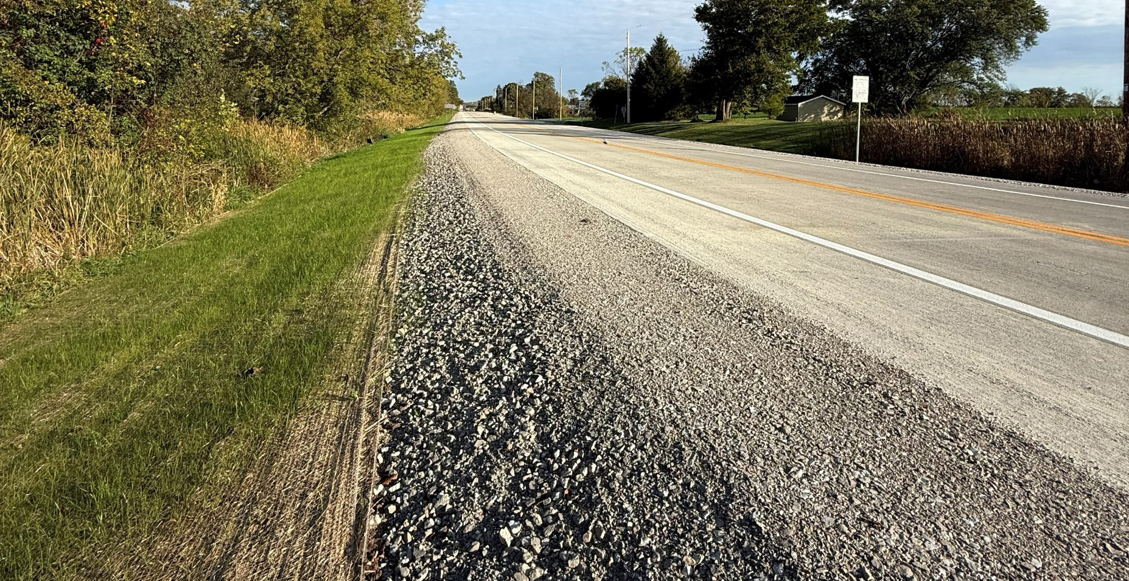
Transportation Services
Funding Opportunities
Secured approximately $3 million in local funding support from the City of Greenfield to reconstruct a half-mile segment of W. Layton Avenue (CTH Y) from S 68th St to S 60th St
Recruitment and Retention
Recruited and filled engineer position and construction coordinator position critical to delivering projects on time, within budget, and of quality.
Supported the efforts of the Human Resources Department’s Compensation Transformation project aimed at aligning salaries with market rates and streamlining pay structures to improve recruitment, enhance retention, and boost morale

Slide 10
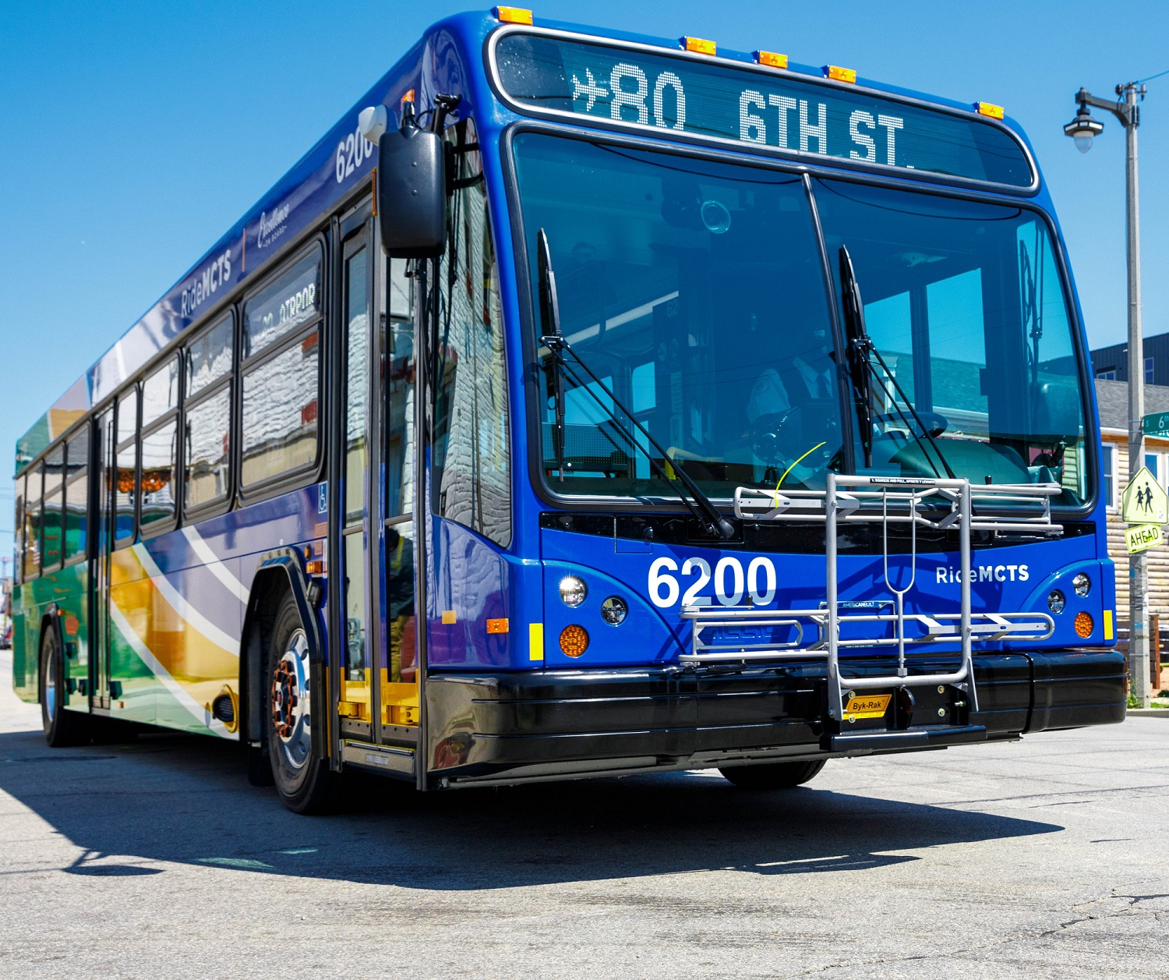
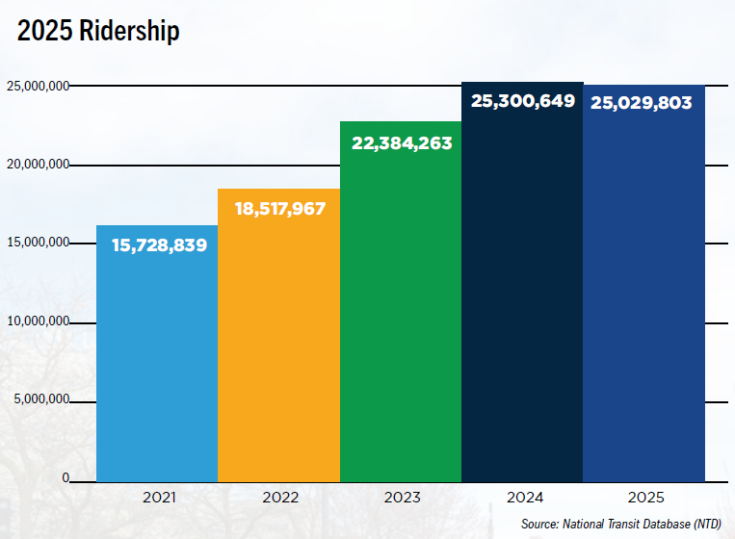
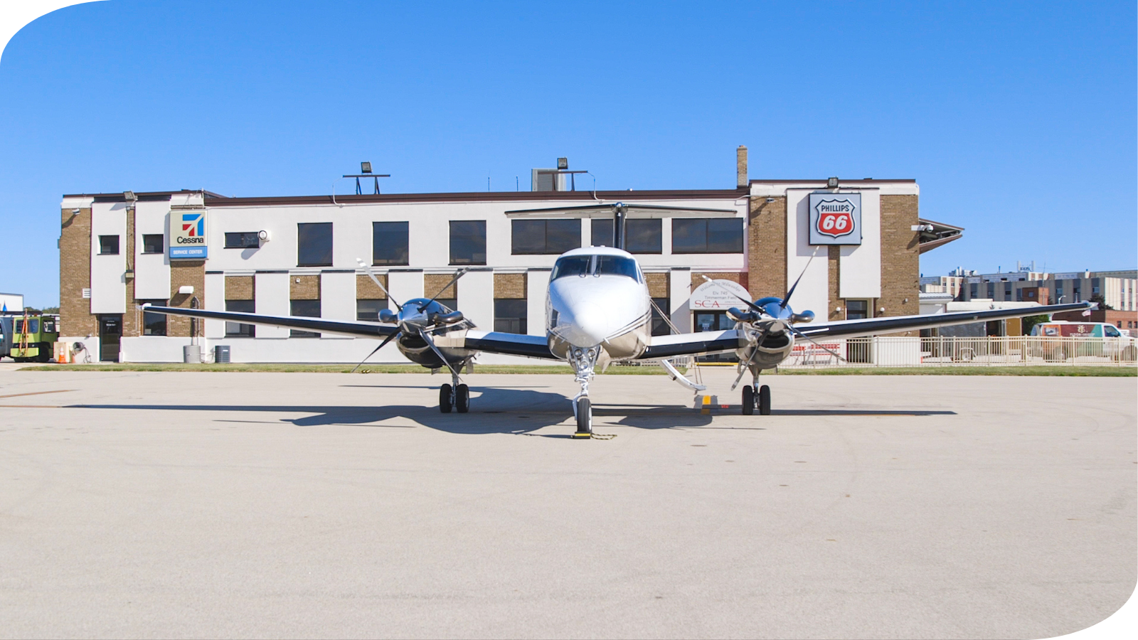
Transit/Paratransit
Sustainability and efficiency initiatives
Safety and security investments
Recruitment and retention efforts
Ongoing efforts to improve paratransit services

Slide 11
Notes:
Ask for volunteers to help be a thought partner in soldifying findings
Updates
1:05-1:25
Jim: Branding
1:25-1:30
Content Collab
Reminder
1:30-1:35
Breakout rooms
1:35-1:45
Shareback
1:45-2:00

