Slide 1

Milwaukee County Sheriff’s Office
26-430
2025 Annual Report to the Milwaukee County Board of Supervisors

Slide 2
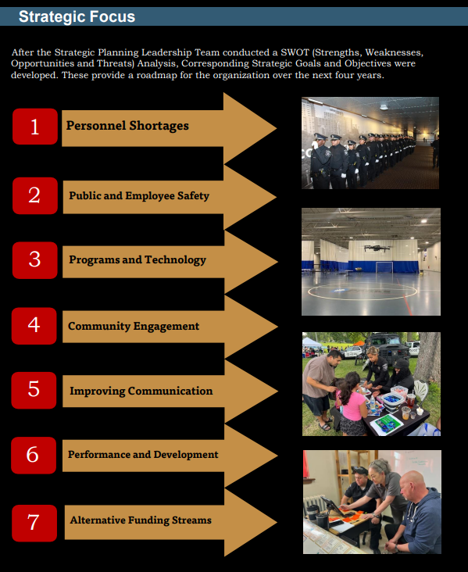

Our
Strategy

Slide 3
Goal 1: Progressive and Effective Recruitment, Hiring and Retaining Personnel
Highlights of our success in this area include:
Created a new ReadyOp “easy fill” form for deputy sheriff, correctional officer, and civilian applicants, increasing engagement and expanding hiring lists into double digits.
Established an agency-wide recruitment team that deployed members to colleges, career fairs, and public safety events to strengthen hiring and retention efforts.
Expanded the Cadet Post recruitment pipeline, with program graduates joining MCSO and strengthening future staffing efforts.
Implemented an hourly courtroom bailiff pilot program and a deputy sheriff lateral transfer program to expand qualified applicant pools.

Slide 4
Goal 2: To provide proactive, timely, and effective public safety on our freeways, county roads, in our parks, and jail, and for our MCSO personnel and Milwaukee County Jail occupants
Highlights of our successes in this area include:
Recomposed the seasonal Parks Unit, contributing to a 36% reduction in Part I crimes in Milwaukee County parks.
Implemented more strategic freeway deployments, increasing OWI, reckless driving, and road rage enforcement activity.
Partnered with MPD and implemented the HAAS Safety Alert System to improve freeway safety and reduce dangerous driving incidents.
Provided enhanced leadership training for all supervisors and expanded jail wellness and safety initiatives.

Slide 5
Goal 3: To implement a comprehensive community engagement strategy that fosters community partnerships between our diverse communities to strengthen relationships and build trust as we work towards a safer community.
Highlights of our successes in this area include:
Launched the Civilian Volunteer Program to support community engagement efforts and expand outreach capacity.
Established the Sheriff’s Community Advisory Board with 17 community members to strengthen transparency and partnerships.
Hosted public town halls, internship initiatives, and community events including the 5th Annual 414 Trust Kickball Tournament.
Expanded partnerships with community organizations including the Red Cross and Sherman Park Neighborhood Watch.

Slide 6
Other notable changes from 2025
The Milwaukee County Jail earned NCCHC best practice re-accreditation.
Implemented the Falcon Suicide Prevention Pilot Program and expanded mental health training.
Expanded collaboration with Wellpath and increased participation in the MAT Program.
Implemented the WRAP restraint device and expanded NARCAN access in housing units.

Slide 7
Looking forward to 2026
MCSO will continue improving recruitment and retention efforts while addressing staffing challenges.
MCSO will continue advocating for funding support for mandated services and jail infrastructure.
MCSO will continue strengthening community engagement, internship, and volunteer initiatives.
MCSO will continue enhancing jail occupant wellness and staff leadership development.
MCSO will continue investing in technology, training, and operational efficiencies to enhance public safety services.
MCSO will continue working collaboratively with community organizations and partner agencies.

Slide 8
Goals Not Yet Fully Met / Ongoing Challenges
Staffing levels remain below operational needs, resulting in continued reliance on overtime to maintain required coverage.
Wage compensation and compression continue to impact recruitment and retention competitiveness.
Court case backlogs continue to contribute to high jail populations and extended occupant stays beyond facility capacity.
Aging security equipment and limited funding continue to impact operational efficiency and facility management.
High jail populations and increasing mental health demands continue to challenge housing, classification, and resource allocation efforts

Slide 9
Questions?

