Slide 1
Office of the Medical Examiner
2025 Annual Report to the Milwaukee County Board of Supervisors

Slide 2
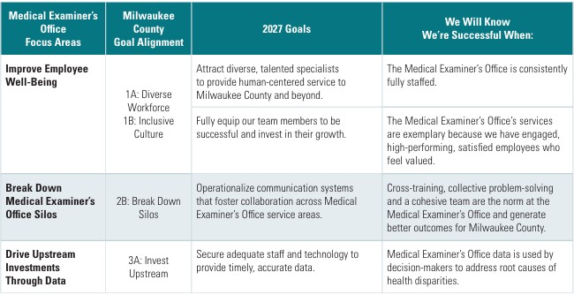

Strategic Plan
Our Mission
Promote and maintain the highest standards in the field of death investigation.
Provide a timely, accurate, and legally defensible cause and manner of death.
Enhance public safety through reducing the incidence of preventable deaths.
Protect the interests of deceased individuals and their families; and serve the community.

Slide 3
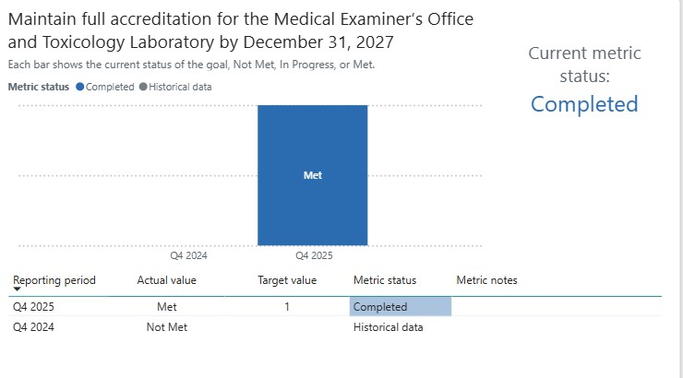
Goal 1 - Achieve full accreditation for the Medical Examiner’s Office and Toxicology Laboratory
Successfully achieved full NAME Accreditation in 2025 after prior provisional status.
Hiring of additional staff reduced workload to 248 autopsies per doctor per year and improved turnaround time from 124 days (2023) to 49 days (2025).
Toxicology Lab maintained ISO/IEC 17025 accreditation.

Slide 4
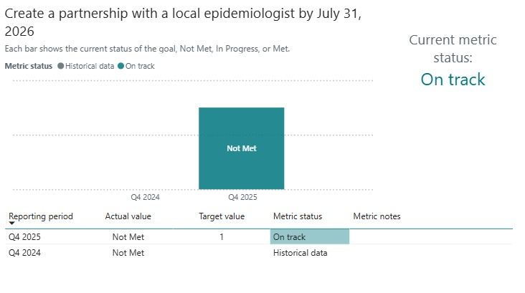
Goal 2 – Establish Epidemiology Partnership
Partnership not yet formalized, but progress being made.
Active collaboration with MCW, OD-PHAST, and multiple death review teams.
Expanded use of ME data to support public health insights and prevention strategies.
Contributed data to Opioid Overdose Dashboard (launched 2025) and crash dashboard.

Slide 5
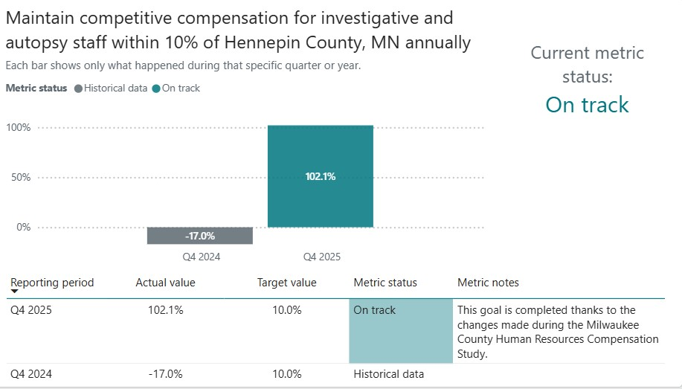
Goal 3 – Maintain Competitive Compensation
Achieved target benchmark: within 10% of Hennepin County ME Office
Implemented compensation study adjustments and new pay grades
Provided targeted increases to increase retention
Improved positioning for recruitment and retention of qualified staff
Conditions could change with loss of staff funded by Opioid Settlement Funds

Slide 6
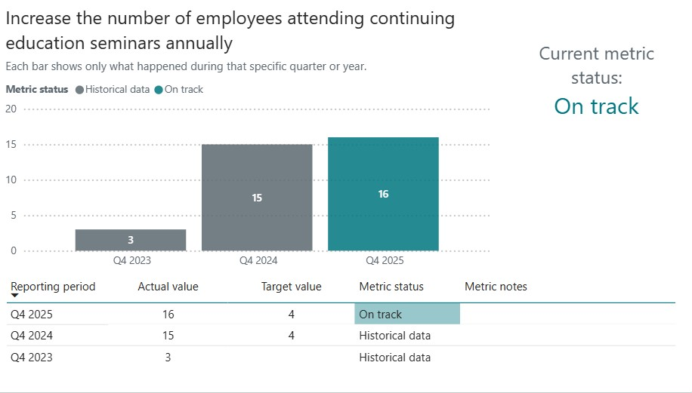
Goal 4 – Expand Continuing Education
16 staff members (cross-functional) participated in continuing education
Monthly in-service training (hybrid format) with broad staff participation
Participation in national conferences, state meetings, and lab collaborations
Leveraged virtual learning to support all shifts and operational needs
Financial constraints still limit ability for all available staff to attend seminars

Slide 7
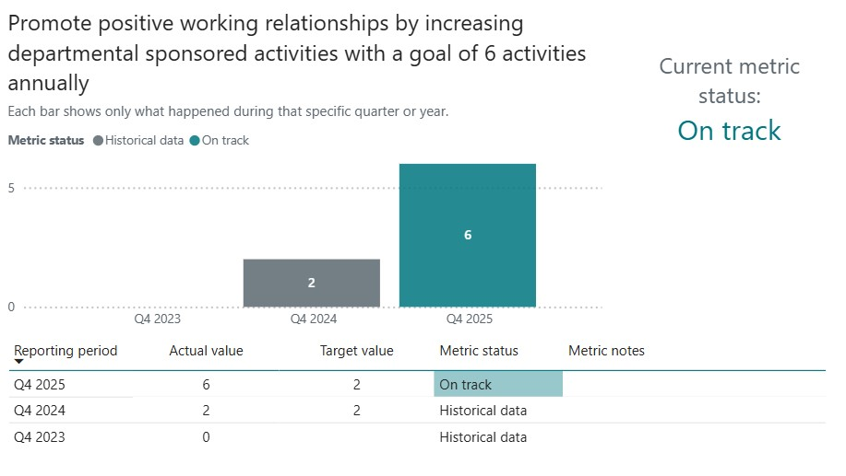
Goal 5 – Strengthen Workplace Culture & Engagement
Met goal with 6 departmental activities in 2025
Hosted holiday parties, office luncheons, and themed pot-luck events
Strong participation and engagement across all teams
Continued focus on employee well-being, collaboration, and retention

Slide 8
Other highlights from 2025
Completed ARPA-funded case management modernization, implementing Forensic Advantage and Clinisys with full financial integration into INFOR
Hired Operations Manager and Medical Records Coordinator, solidifying the administrative side of our department
Preformed 456 examinations for outside jurisdictions, expanding regional partnerships and generating additional revenue
Lowered Turn Around Time on case completion to 49 days

Slide 9
Looking forward to 2026
Transition to new Forensic Science Center (2026): Enhancing capacity, technology, and regional collaboration
Implementation of new financial policy for delinquent funeral homes: Strengthening accountability and improving revenue collection
Continued modernization of operations. Leveraging new systems for record storage and modernizing payment options
Expansion of regional partnerships: growing our toxicology lab for the future
Focus on maintaining adequate staffing to continue providing timely and accurate results and data

