Slide 1
Request to Enter Into Long-term Lease with Easterseals Southeast Wisconsin
Department of Administrative Services
Department of Health and Human Services
Parks Department

Slide 2
Strategic Opportunity
Milwaukee County DHHS, Parks and DAS request authorization to execute long-term leases for the Wil-O-Way Grant and Underwood facilities to Easterseals of Wisconsin
  Reduces long-term County operating and capital obligations
  Preserves and expands inclusive recreation and respite programming
  Maintains mission-serving community use within Milwaukee County Parks
  Aligns with County strategic goals around fiscal sustainability and health

Slide 3
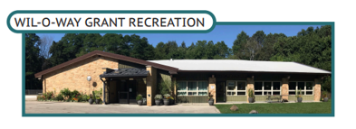
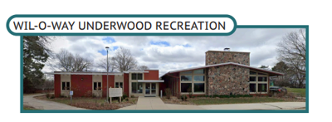
Strategic Alignment
Milwaukee County strategy to reduce deferred maintenance liabilities
Wil-O-Way lease structure reflects this broader strategy
  Focus on aligning facilities with core service delivery priorities
  Leverage partnerships with trusted nonprofit organizations
  Preserve valued public programming while improving fiscal sustainability
  Milwaukee County continues strategy to reduce long-term deferred maintenance liabilities

Slide 4
Fiscal Impact & Cost Avoidance
Estimated 5-year capital needs for both Wil-o-Way Facilities: ~ $4.84 million
Average annual operating costs: ~$112,682
Under proposed lease, County would contribute $0 for capital and operating (not including splashpads or areas outside of lease)
Easterseals assumes:
  Utilities
  Maintenance responsibilities
  Capital obligations

Slide 5
Key Lease Terms
Lease Start Date | January 1, 2027
Initial Term | 10 years
Renewal Options | Two additional five-year renewal periods
Rent | $1 annually
Utilities | Tenant responsibility
Maintenance | Tenant responsibility
Capital Improvements | Tenant responsibility
Easterseals Reserve Requirement | $50,000 maintenance and replacement reserve fund
County Termination Rights | 270-day termination for convenience; 30-day termination for continuing default

Slide 6
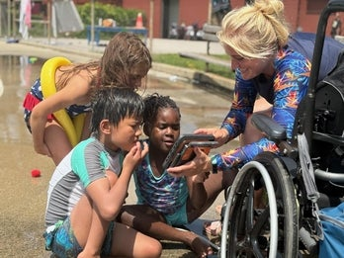

Mission Alignment & Community Impact
Easterseals has partnered with Milwaukee County for more than a decade.
Provides inclusive recreation, respite care, camps, and life skills programming.
Serves youth, adults, seniors, caregivers, and persons with disabilities.
Supports accessibility, inclusion, independence and community engagement.
Advances Milwaukee County strategic objectives and DHHS mission.

Slide 7
Recommendation
Authorize DAS, Parks, and DHHS to execute long-term lease agreements.
  Preserve and expand inclusive community programming.
  Reduce future County capital and operational obligations.
  Advance Milwaukee County’s long-term facilities and fiscal strategy.

Slide 8

Questions?

